Slide 1
Linear Models II: Logistic and Poisson (count) regression-an introduction to Generalised Linear Models (GLM)
Presented by
Chris Howden
Sydney Informatics Hub
Core Research Facilities
The University of Sydney
Notes:
INTRO: KEEP IT SHORT IF I AM GOING TO DO THIS IN 5 MIN
Setting a Positive impression and tone of the workshop. Whet learners appetite
Introduce yourself effectively (and have other workshop leaders do the same)
Example:
Hi Everyone, My name is Chris Howden and I am the lead at the statistics unit at the Sydney Informatics Hub. I have about 20 years experience across the Academic, Public and Commercial sectors. Today I’ll be using that bring you Practical workflows and tips you can use in your research, this isn’t about the theory!! Its about hands on useful workflows.
We also have XX who will be answering your questions in the chat, so please feel free to ask them in there. And to also ask me questions verbally as we go.
ALSO GET THEIR VIDEO ON BY SAYING
“If you could pls turn on yr video to say hi that’d be great”
Really appreciate if you could leave them on makes it much easier for me if I am talking to people not a blank screen. Plus I can see your confused faces if I need to explain something again.
Thanks”
AND REMEMBER TO USE THE LASER POINTER
Use the Laser Pointer since then I can have the PPT presenting screen with the slide, notes and next slide up in front of me and point to it – PPT also shows it on the screen users see. The mouse pointer doesn’t do that.
LINEAR MODELS 2 TIMING
print and mark time as I go
0:00 Intro (5 min)
0:05 Framework (40 min)
0:25 ½ framework – not sure where maybe finished table parts
0:45 Logistic (25 min)
1:10 Poisson (15 min)
1:25 Wrap Up (5 min)
1:30 Done
PAST TRAININGS
9-5-2023 ~ Finished the Framework in 30min, with 10 minutes to spare!
30-8-2022 ~ Ontime
10-3-2021 ~ Ontime
8-9-2020 ~ Did initial section too quickly, only 30 min spent on it.

Slide 2

Acknowledging SIH
All University of Sydney resources are available to Sydney researchers free of charge. The use of the SIH services including the Artemis HPC and associated support and training warrants acknowledgement in any publications, conference proceedings or posters describing work facilitated by these services.
The continued acknowledgment of the use of SIH facilities ensures the sustainability of our services.
Suggested wording:
General acknowledgement:
"The authors acknowledge the technical assistance provided by the Sydney Informatics Hub, a Core Research Facility of the University of Sydney."
Acknowledging specific staff:
“The authors acknowledge the technical assistance of (name of staff) of the Sydney Informatics Hub, a Core Research Facility of the University of Sydney.”
For further information about acknowledging the Sydney Informatics Hub, please contact us at sih.info@sydney.edu.au.

Slide 3
We value your feedback
We aim to help HDR students and researchers in a wide range of fields across different faculties
We want to hear about you and whether this workshop has helped you in your research.
Later in this workshop there will be a link to a survey
It only takes a few minutes to complete (really!)
Completing this survey will help us create workshops that best meet the needs of researchers like you

Slide 4



During the workshop
Ask short questions or clarifications during the workshop. There will be breaks during the workshop for longer questions.
Slides with this blackboard icon are mainly for your reference, and the material will not be discussed during the workshop.
Challenge Question
A wild boar is coming towards you at 200mph. Do you:?
  A. Ask it directions
  B. Wave a red flag
  C. Wave a white flag
  D. Begin preparing a trap

Slide 5
After the workshop
These slides should be used after the workshop as Workflows and reference material.
Todays workshop gives you the statistical workflow, which is software agnostic in that they can be applied in any software.
There are also accompanying software workflows that show you how to do it. We won’t be going through these in detail. But if you have problems we have a monthly hacky hour where people can help you.
1on1 assistance
You can email us about the material in these workshops at any time
Or request a consultation for more in-depth discussion of the material as it relates to your specific project. Consults can be requested via our Webpage (link is at the end of this presentation)

Slide 6
Research Workflow
Why do we use a research workflow?
  As researchers we are motivated to find answers quickly
  This drive can cause problems if we don’t think systematically
  … and we need to in order to:
    Find the right method
    Use it correctly
    Interpret and report our results accurately
  The payoff is huge, we can avoid mistakes that would affect
  the quality of our work and get to the answers sooner
So… what is a workflow?
  The process of doing a statistical analysis follows the same general “shape”.
  We provide a general research workflow, and a specific workflow for each major step in your research
  (currently experimental design, power calculation, analysis using linear models/survival/multivariate/survey methods)
  You will need to tweak them to your needs
Notes:
SCRIPT
The reason we use a workflow is that it helps us:
Find the Optimal analysis that finds the most interesting patterns. That helps us get published in the better journals.
Workflow is a bit of a recipe. It’s not the same for everyone, Different chefs and different cooks may change things a little. There is nothing wrong with you taking what we are give you and tweaking it for your needs or domain.

Slide 7











General Research Workflow
Hypothesis Generation (Research/Desktop Review)
Experimental and Analytical Design (sampling, power, ethics approval)
Collect/Store Data
Data cleaning
Exploratory Data Analysis (EDA)
Data Analysis aka inferential analysis
Predictive modelling
Publication
Notes:
Today I’m talking about these 2

Slide 8
CONTENTS: Generalised Linear Models II
First, we will explain the Generalised Linear Model Framework and how it is just an extension of the Simple Linear Framework introduced in Workshop I.
Statistical Workflows for:
Logistic (binary) regression
Poisson (count) regression
These workflows are software agnostic but also have accompanying R code if you wish to do it in R. Plots are done using a combination of default plotting functions and ggplot functions. You will know the difference since ggplot functions start with ggplot().
Notes:
TIMING – print and mark time as I go
0:00 Intro (5 min)
0:05 Framework (40 min)
0:25 ½ framework – not sure where maybe finished table parts
0:45 Logistic (25 min)
1:10 Poisson (15 min)
1:25 Wrap Up (5 min)
1:30 Done
11:30 Intro (5 min)
11:35 Framework (40 min)
12:00 ½ framework – not sure where maybe finished table parts
12:15 Logistic (25 min)
12:40 Poisson (15 min)
12:55 Wrap Up (5 min)
13:00 Done
PAST TRAININGS
10-3-2021 ~ ontime
8-9-2020 ~ Did initial section too quickly, only 30 min spent on i.

Slide 9
Generalised Linear Models Framework
Simple Linear Models (workshop 1) vs generalised Linear Models (workshop 2+)
Introducing the concepts of:
Design Matrix
Linear Predictor
Data Distribution
Link Function

Slide 10
What are Generalised Linear Models?
ANOVA
Linear Regression
ANCOVA
Logistic (Binary) regression
Before After Control Impact (BACI) Studies
Count (Poisson) regression
Randomised Control Trials (RCT’s)
Repeated measures
Plus Many More!!

Slide 11
A single unifying Theory
In Linear Models I we showed that although Regression and ANOVA are often taught as different things, they aren’t. Instead it’s much easier to understand them using a single unifying Linear Models theory.
This allows us to apply them using the same workflow.
In this workshops we extend this theory to allow non normal (gaussian) errors and responses. This extended theory is called:
Generalised Linear Models

Slide 12

We’re gonna need some Equations
DON’T FREAK OUT!!!
Couple tricks with equations:
They are a language.
  Each symbol represents a concept, so learn the concept to learn the equation.
  Then write the equation out in your native tongue
If you don’t get the concept that’s fine. Just work on it a little bit each day. Like any language.
EG: Y_{i} = β_{ο} + ε_{i}
Means something called Y equals something called Beta Zero plus some Error.

Slide 13


Don’t get lost in the detail. Get the lay of the land at a Conceptual - big scale. And then come back and zoom into the detail when you have time.

Slide 14
We are covering a lot in this first section, so don’t worry if you get a little lost.
Just get the Big Picture, remember where you get lost, and then come back and learn a little more each day.
If you can just get the take homes in these red boxes today that’s a great start. The main concepts are:
        Design Matrix
        Linear Predictor
        Data Distribution
        Link Function

Slide 15
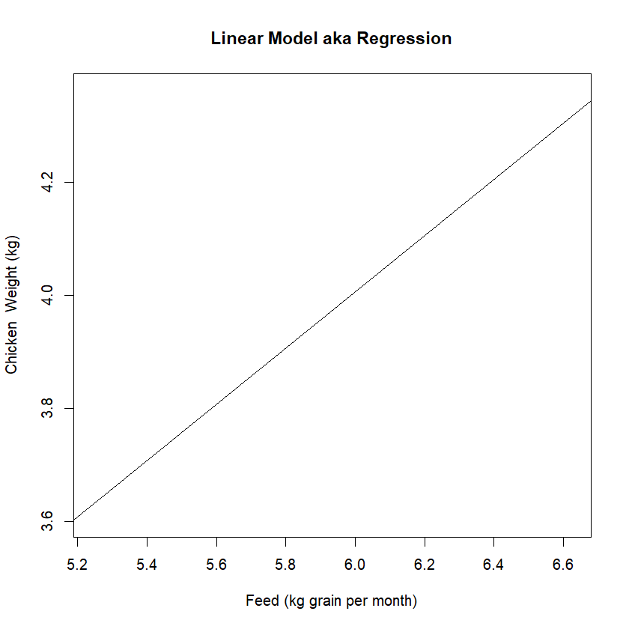
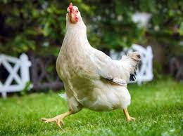
Simple Linear Model
Your Turn: Draw a linear model for the weight of chicken compared to the amount of feed it eats in its first month.
So in this example a chicken that eats 6 kg of Feed will weigh about 4kg

Slide 16
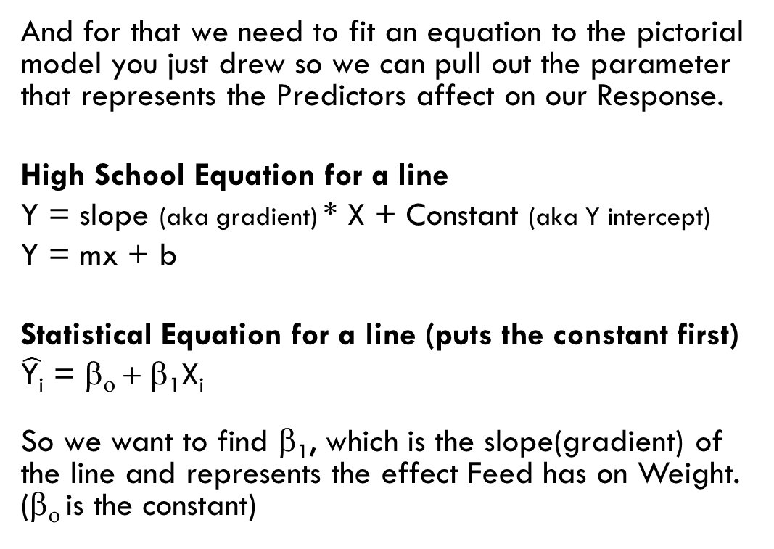
So we know it’s linear. Is that all we need to know?
NO! We want to know exactly how our Predictor (feed) affects our Response (weight).
And for that we need to fit an equation to the pictorial model you just drew so we can pull out the parameter that represents the Predictors affect on our Response.
High School Equation for a line
Y = slope (aka gradient) * X + Constant (aka Y intercept)
Y = mx + b
Statistical Equation for a line (puts the constant first)
$\hat{\text{Y}\text{i}}$ = β_{ο} + β₁X_{i}
So we want to find β₁, which is the slope(gradient) of the line and represents the effect Feed has on Weight. (β_{ο} is the constant)

Slide 17
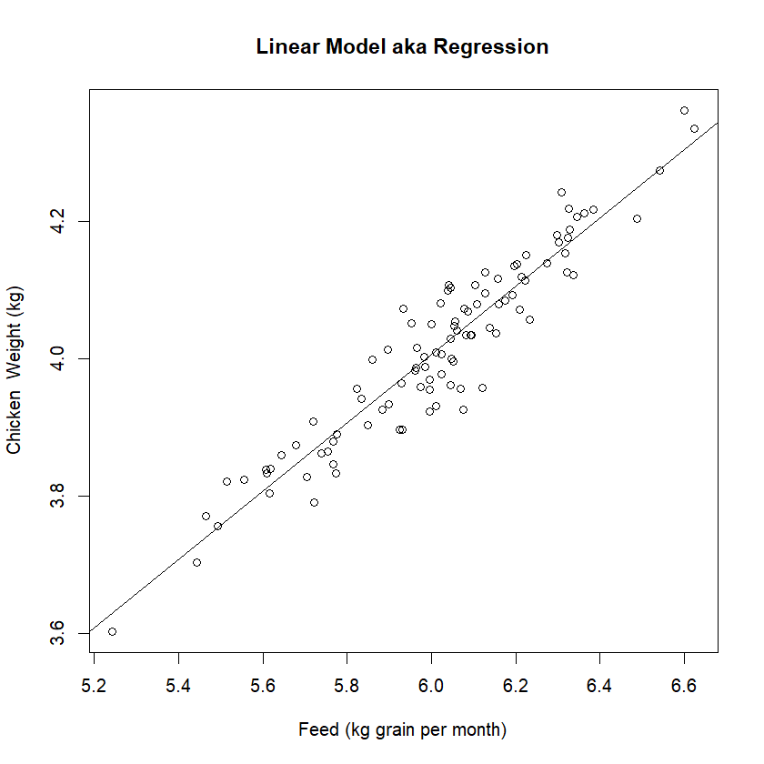
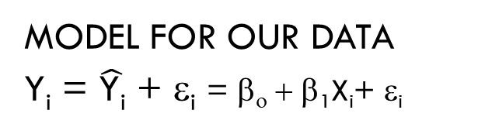
But we’re still missing something?
THE DATA!!!!!
Each datum has it’s own natural variance from the line since each chicken is a bit different!
Another name for the Natural Variance is the “Error” of the model. Which is why we usually represent it as an ε in the model.
MODEL FOR A LINE
$\hat{\text{Y}\text{i}}$ = β_{ο} + β₁X_{i}
MODEL FOR OUR DATA
Y_{i} = $\hat{\text{Y}\text{i}}$ + ε_{i} = β_{ο} + β₁X_{i}+ ε_{i}
$\hat{\text{Y}}$ ~ The “hat” over the $\hat{\text{Y}}$ tells us that it’s a prediction of Y for those specific predictor values for X.
Y ~ Is the actual value of Y, so it’s the prediction + error.

Slide 18
So let’s look at all the different components of this equation so we can generalise it to more complex models. Such as:
More than 1 continuous variable
Categorical variables
Non normal error
MODEL FOR OUR DATA
Y_{i} = $\hat{\text{Y}\text{i}}$ + ε_{i} = β_{ο} + β₁X_{i}+ ε_{i}
Notes:
TO DO: Merge with next slide

Slide 19
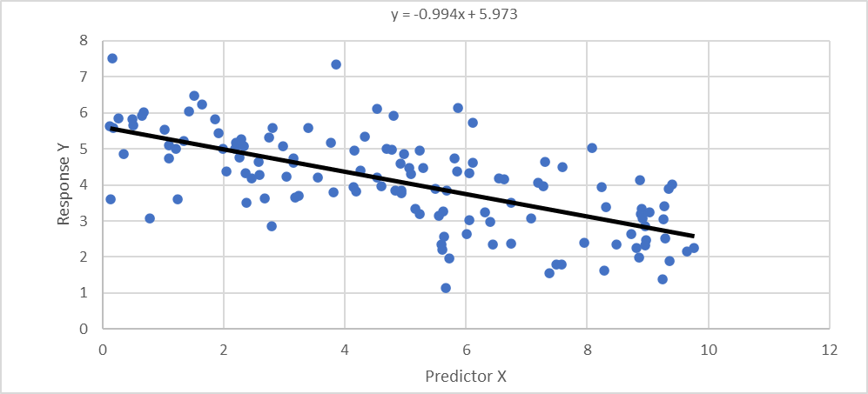
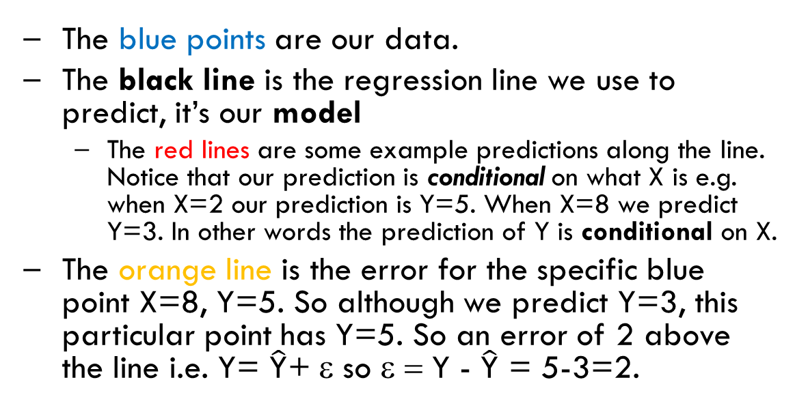
The blue points are our data.
The black line is the regression line we use to predict, it’s our model
  The red lines are some example predictions along the line. Notice that our prediction is conditional on what X is e.g. when X=2 our prediction is Y=5. When X=8 we predict Y=3. In other words the prediction of Y is conditional on X.
The orange line is the error for the specific blue point X=8, Y=5. So although we predict Y=3, this particular point has Y=5. So an error of 2 above the line i.e. Y= $\hat{\text{Y}}$+ ε so ε = Y - $\hat{\text{Y}}$ = 5-3=2.
Notes:
TO DO: merge with previous slide

Slide 20
Simple Regression – Numeric Statistical Model
Y_{i} = β_{ο}X_{0i} + β₁X_{1i} + ε_{i}
Actual Y value = Linear Prediction + Error/Natural Variation
Data (the actual data you collect)
Y_{i} ~ Response of Observation i
X_{1i} ~ Predictor X₁ of Observation i
Design Matrix Parameters (the parameters in your model i.e. the actual data you model)
X_{oi} ~ design parameter for parameter β₀ (Constant/Y intercept)
X_{1i} ~ design parameter for β₁ (parameter X_{1i})
Model Variables (variables the model calculates)
$\hat{\text{Y}\text{i}}$ ~ Prediction for Observation i ε_{i} ~ Error of Observation i
β₀ ~ Constant/Y intercept parameter β_{1 i} ~ parameter for predictor 1
Notes:
So we start with our data (in red). We have a response and a single continuous predictor.
BUT have a close look at our MODEL (point to equation). There is something in the equation not in the data.
CQ) what might that be??? The Constant/Y intercept, so how do we include it? Any ideas?
Well the first important concept for you to get your hear around is that you don’t really model the data. You model a design matrix which is often created in the background and is certainly based on the data. And it’s here where we have 1 column of data for each parameter in our equation.
1 for the Constant/Y intercept
1 for the continuous predictor
Then finally the other variables that the model calculates?

Slide 21
Simple Regression – Numeric Statistical Model
Y_{i} = β_{ο}X_{0i} + β₁X_{1i} + ε_{i}
Actual Y value = Linear Prediction + Error/Natural Variation
Take Home
We only indirectly model the data. What we actually model is the design matrix, this is usually created in the background by the software.
You can fit Fancy Models by using a Fancy Design Matrix. Examples of parameters not in the data but are in the design matrix include:
  Intercept – so you can remove it to force the line through the origin e.g. calibrations.
  Polynomials e.g. add a quadratic term to fit a parabola curve.
Notes:
Take Home

Slide 22

Simple Regression – Numeric Statistical Model
Y_{i} = β_{ο}X_{0i} + β₁X_{1i} + ε_{i}
Actual Y value = Linear Prediction + Error/Natural Variation
Take Home
We only indirectly model the data. What we actually model is the design matrix, this is usually created in the background by the software.
You can fit Fancy Models by using a Fancy Design Matrix. Examples of parameters not in the data but are in the design matrix include:
  Intercept – so you can remove it to force the line through the origin e.g. calibrations.
  Polynomials e.g. add a quadratic term to fit a parabola curve.
Notes:
Take Home

Slide 23
Let’s add another continuous predictor variable
Yellow represents the changes required for this to happen

Slide 24
Multiple Regression
Notice the predictions have changed and the errors are overall smaller (although some are individually larger). As expected when we add new parameters.
Y_{i} = β_{ο}X_{0i} + β₁X_{1i} + β₂X_{2i} + ε_{i}
Actual Y value = Linear Prediction + Error/Natural Variation
Data (the actual data you collect)
Y_{i} ~ Response of Observation i
X_{1i} ~ Predictor X₁ of Observation i
X_{2i} ~ Predictor X₂ of Observation i
Design Matrix Parameters (the parameters in your model i.e. the actual data you model)
X_{oi} ~ design parameter for parameter β₀ (Constant/Y intercept)
X_{1i} ~ design parameter for β₁ (parameter X_{1i})
X_{2i} ~ design parameter for β₂ (parameter X_{2i})
Model Variables (variables the model calculates)
$\hat{\text{Y}\text{i}}$ ~ Prediction for Observation i ε_{i} ~ Error of Observation i
β₀ ~ Constant/Y intercept parameter β_{1 i} ~ parameter for predictor 1
β_{2i} ~ parameter for predictor 2
Notes:
1 new predictor means 1 more parameter in the design matrix

Slide 25
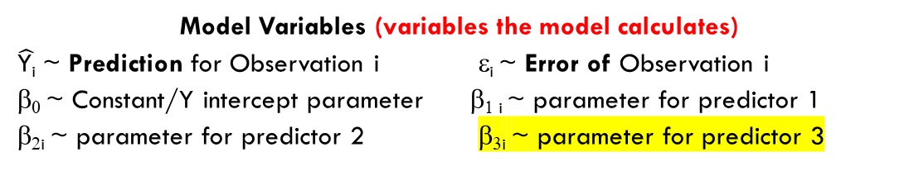
Multiple Regression
A new design matrix predictor is simply added for any new continuous predictors you want.
Just keep going!!
Y_{i} = β_{ο}X_{0i} + β₁X_{1i} + β₂X_{2i} + β₃X_{3i} + ε_{i}
Actual Y value = Linear Prediction + Error/Natural Variation
Data (the actual data you collect)
Y_{i} ~ Response of Observation i
X_{1i} ~ Predictor X₁ of Observation i
X_{2i} ~ Predictor X₂ of Observation i
X_{3i} ~ Predictor X₃ of Observation i
Design Matrix Parameters (the parameters in your model i.e. the actual data you model)
X_{oi} ~ design parameter for parameter β₀ (Constant/Y intercept)
X_{1i} ~ design parameter for β₁ (parameter X_{1i})
X_{2i} ~ design parameter for β₂ (parameter X_{2i})
X_{3i} ~ design parameter for β₃ (parameter X_{3i})
Model Variables (variables the model calculates)
$\hat{\text{Y}\text{i}}$ ~ Prediction for Observation i ε_{i} ~ Error of Observation i
β₀ ~ Constant/Y intercept parameter β_{1 i} ~ parameter for predictor 1
β_{2i} ~ parameter for predictor 2 β_{3i} ~ parameter for predictor 3
Notes:
Add some more to give them the idea

Slide 26
Multiple Regression
A new design matrix predictor is simply added for any new continuous predictors you want.
Just keep going!!
Y_{i} = β_{ο}X_{0i} + β₁X_{1i} + β₂X_{2i} + β₃X_{3i} + ε_{i}
Actual Y value = Linear Prediction + Error/Natural Variation
Data (the actual data you collect)
Y_{i} ~ Response of Observation i
X_{1i} ~ Predictor X₁ of Observation i
X_{2i} ~ Predictor X₂ of Observation i
X_{3i} ~ Predictor X₃ of Observation i
Design Matrix Parameters (the parameters in your model i.e. the actual data you model)
X_{oi} ~ design parameter for parameter β₀ (Constant/Y intercept)
X_{1i} ~ design parameter for β₁ (parameter X_{1i})
X_{2i} ~ design parameter for β₂ (parameter X_{2i})
X_{3i} ~ design parameter for β₃ (parameter X_{3i})
Model Variables (variables the model calculates)
$\hat{\text{Y}\text{i}}$ ~ Prediction for Observation i ε_{i} ~ Error of Observation i
β₀ ~ Constant/Y intercept parameter β_{1 i} ~ parameter for predictor 1
β_{2i} ~ parameter for predictor 2 β_{3i} ~ parameter for predictor 3
Notes:
Any Q’s. We are going to build off this so its really important you understand this. So if you don’t please speak up!!!

Slide 27
So how do we add Categorical variables??
Yellow represents the changes required for this to happen

Slide 28
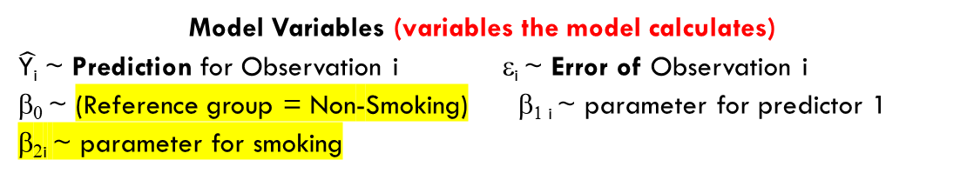
Adding Categorical Variables (e.g. ANOVA)
Y_{i} = β_{ο}X_{0i} + β₁X_{1i} + β₂X_{2i} + ε_{i}
Actual Y value = Linear Prediction + Error/Natural Variation
Data (the actual data you collect)
Y_{i} ~ Response of Observation i
X_{1i} ~ Predictor X₁ of Observation i
X_{2i} ~ Predictor X₂ of Observation i
Design Matrix Parameters (the parameters in your model i.e. the actual data you model)
X_{oi} ~ design parameter for parameter β₀ (Reference group = Non-Smoking)
X_{1i} ~ design parameter for β₁ (parameter X_{1i})
X_{2i} ~ design parameter for β₂ (parameter X_{2i} = smoking)
Model Variables (variables the model calculates)
$\hat{\text{Y}\text{i}}$ ~ Prediction for Observation i ε_{i} ~ Error of Observation i
β₀ ~ (Reference group = Non-Smoking) β_{1 i} ~ parameter for predictor 1
β_{2i} ~ parameter for smoking
Notes:
So we have added smoking vs non smoking into our Data.
But how do we add that to our design matrix? We can’t add text, we need to add it as a number.

Slide 29
Adding Categorical Variables (e.g. ANOVA)
Y_{i} = β_{ο}X_{0i} + β₁X_{1i} + β₂X_{2i} + ε_{i}
Actual Y value = Linear Prediction + Error/Natural Variation
There are many different parameterisations (ways) to model categorical variables. The way I am showing you is called Dummy or Treatment Coding. Dummy coding works by picking 1 category as the reference category, this category is captured in the constant/intercept parameter and is always ‘on’. We then adjust it when a different category is present by adding their specific parameter into the prediction equation/model.
This means that every other category other than the reference category has it’s own design parameter which functions as an ‘indicator variable” since:
When X₂ = 1 it “turns on” β₂ since β₂X_{2i} = β₂*1 = β₂
  β₂ only comes into the model when X₂ = 1, i.e. when people smoke i.e. it is the extra effect of smoking compared to the baseline reference level of not smoking.
When X₂ = 0 it “turns off” β₂ since β₂X_{2i} = β₂*0 = 0
  We only have β₀ when people don’t smoke i.e. X₂ = 0, i.e. it is the baseline prediction when people don’t smoke i.e. it’s the reference level.
Notes:
TO DO: MERGE WITH ABOVE SLIDE (which is hidden so we wont see it in the delivered slides)
DO I need to add this??
When it comes to the categorical variable we can ignore the β₁X_{1i,} it’s the effect of X1 on Y, irrelevant to whether someone smokes.

Slide 30
Adding Categorical Variables (e.g. ANOVA)
Y_{i} = β_{ο}X_{0i} + β₁X_{1i} + β₂X_{2i} + ε_{i}
Actual Y value = Linear Prediction + Error/Natural Variation
Linear Models 3 goes into more detail by:
discussing other ways to model categorical variables, such as effects coding
having a worked example of how the deign matrix combine with the models estimated parameters to give the predictions.
Notes:
TO DO: MERGE WITH ABOVE SLIDE (which is hidden so we wont see it in the delivered slides)
DO I need to add this??
When it comes to the categorical variable we can ignore the β₁X_{1i,} it’s the effect of X1 on Y, irrelevant to whether someone smokes.

Slide 31
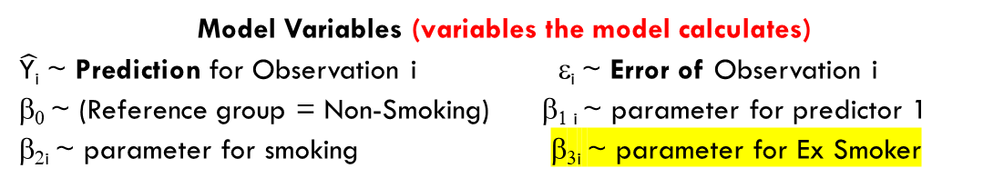
Adding Categorical Variables (e.g. ANOVA)
A new design matrix predictor is simply added for any new categorical levels you want.
Just keep going!!
Y_{i} = β_{ο}X_{0i} + β₁X_{1i} + β₂X_{2i} + β₃X_{3i} + ε_{i}
Actual Y value = Linear Prediction + Error/Natural Variation
Data (the actual data you collect)
Y_{i} ~ Response of Observation i
X_{1i} ~ Predictor X₁ of Observation i
X_{2i} ~ Predictor X₂ of Observation i
Design Matrix Parameters (the parameters in your model i.e. the actual data you model)
X_{oi} ~ design parameter for parameter β₀ (Reference group = Never Smoked)
X_{1i} ~ design parameter for β₁ (parameter X_{1i})
X_{2i} ~ design parameter for β₂ (parameter X_{2i} = Smoking)
X_{3i} ~ design parameter for β₂ (parameter X_{3i} = Ex Smoker)
Model Variables (variables the model calculates)
$\hat{\text{Y}\text{i}}$ ~ Prediction for Observation i ε_{i} ~ Error of Observation i
β₀ ~ (Reference group = Non-Smoking) β_{1 i} ~ parameter for predictor 1
β_{2i} ~ parameter for smoking β_{3i} ~ parameter for Ex Smoker
Notes:
So we have added smoking vs non smoking into our Data.
But how do we add that to our design matrix? We can’t add text, we need to add it as a number.

Slide 32
What’s the difference with multiple regression?
Virtually none. The underlying model is exactly the same!! The only changes are in the data:
The X predictor is continuous when adding a continuous variable aka multiple regression, while it’s an indicator variable if adding a categorical variable.
Interpretation of the parameters differs.
But they are both still linear models.
_{Take Home}
Categorical ANOVA style models are the same as continuous style regression models. The only difference is in the design matrix.
Y_{i} = β_{ο}X_{0i} + β₁X_{1i} + β₂X_{2i} + β₃X_{3i} + ε_{i}
Actual Y value = Linear Prediction + Error/Natural Variation
Notes:
Add some more to give them the idea

Slide 33
What’s the Difference with Multiple Regression?
Virtually none. The underlying model is exactly the same!! The only changes are in the data:
The X predictor is continuous when adding a continuous variable aka multiple regression, while it’s an indicator variable if adding a discrete variable.
Interpretation of the parameters differs
But they are both still linear models
_{Take Home}
Categorical ANOVA style models are the same as continuous style regression models. The only difference is in the design matrix
Need to link this slide with the next better
Y_{i} = β_{ο}X_{0i} + β₁X_{1i} + β₂X_{2i} + β₃X_{3i} + ε_{i}
Actual Y value = Linear Prediction + Error/Natural Variation
Notes:
Add some more to give them the idea

Slide 34
Representing complex models in a single, simple, concise and generalisable way
Wouldn’t it be great if we could represent any linear models parametric design e.g. ANOVA, regression, ANCOVA, BACI, etc.
Using the same notation?
That would give us a very easy framework to work within.
We wouldn’t need to learn lots of different things, and could instead put lots of different analyses into the same ‘compartment’ in our brain!

Slide 35
The design matrix can represent any model!
Y_{i} = β_{ο}X_{0i} + β₁X_{1i} + β₂X_{2i} + β₃X_{3i} + ….. + ε_{i}
= Xβ + ε_{i} ~ a shorter and simpler way to write any linear model
= linear/additive model
X = design matrix β = vector of ε = vector of ~ the actual data modelled parameters errors
Notes:
FLICK BETWEEN THE 2 SLIDES to show the difference between Y and Yhat
TO DO
is multiplicative it + or * e
Add the y vector

Slide 36
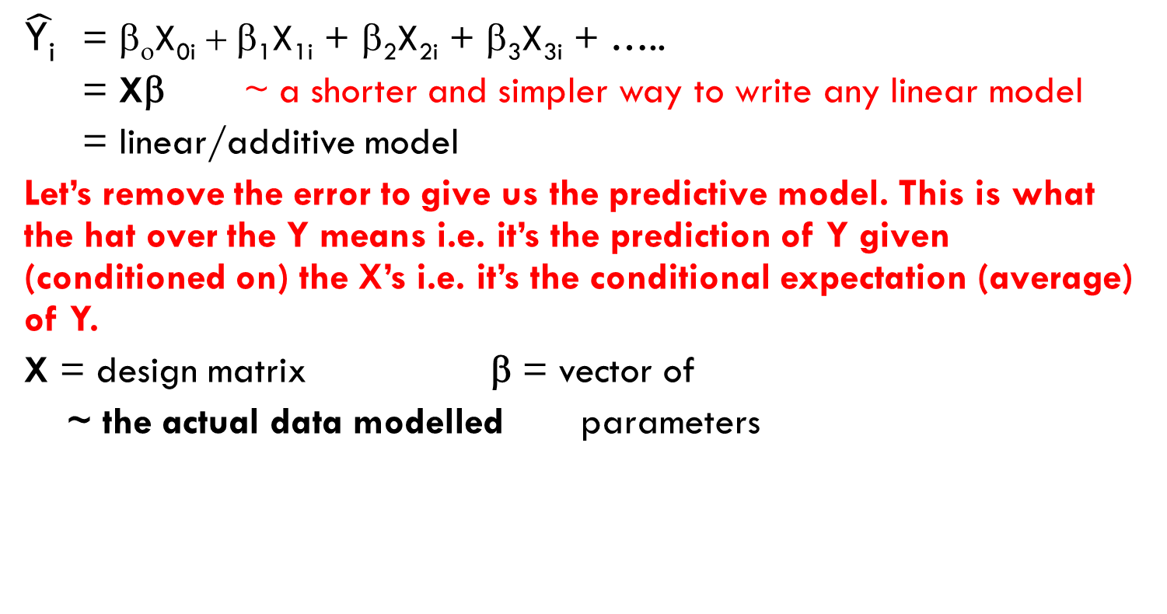
The design matrix can represent any model!
$\hat{\text{Y}\text{i}}$ = β_{ο}X_{0i} + β₁X_{1i} + β₂X_{2i} + β₃X_{3i} + …..
= Xβ ~ a shorter and simpler way to write any linear model
= linear/additive model
Let’s remove the error to give us the predictive model. This is what the hat over the Y means i.e. it’s the prediction of Y given (conditioned on) the X’s i.e. it’s the conditional expectation (average) of Y.
X = design matrix β = vector of
~ the actual data modelled parameters
Notes:
TO DO
is multiplicative it + or * e
Add the y vector

Slide 37
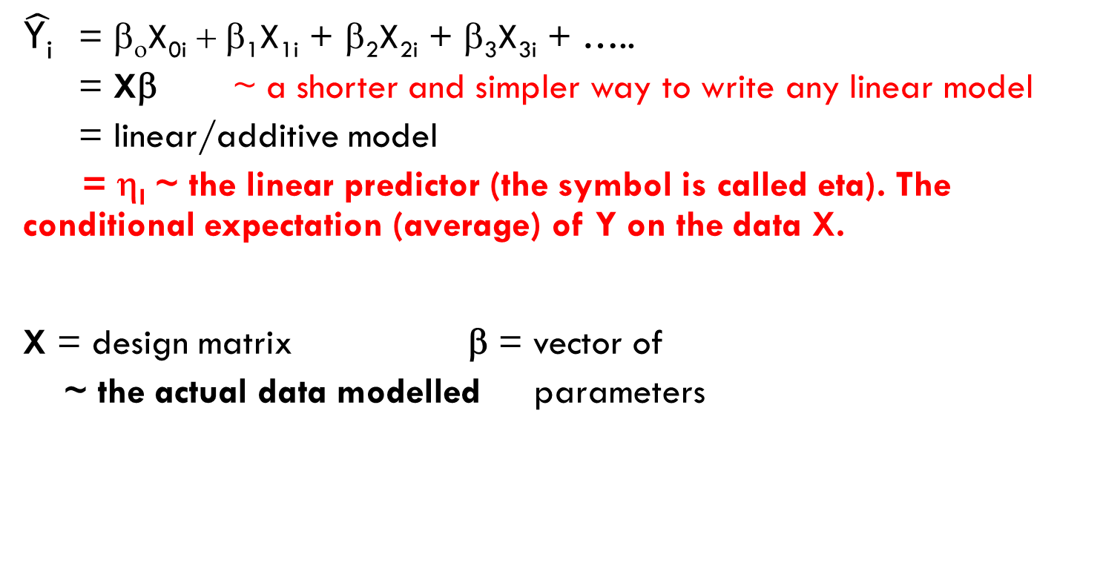
The linear predictor can represent any model!
$\hat{\text{Y}\text{i}}$ = β_{ο}X_{0i} + β₁X_{1i} + β₂X_{2i} + β₃X_{3i} + …..
= Xβ ~ a shorter and simpler way to write any linear model
= linear/additive model
= η_{I} ~ the linear predictor (the symbol is called eta). The conditional expectation (average) of Y on the data X.
X = design matrix β = vector of
~ the actual data modelled parameters
The Linear Predictor (η_{I})
Part 1 of the 3 required for a GLM
Notes:
TO DO
is multiplicative it + or * e
Add the y vector

Slide 38
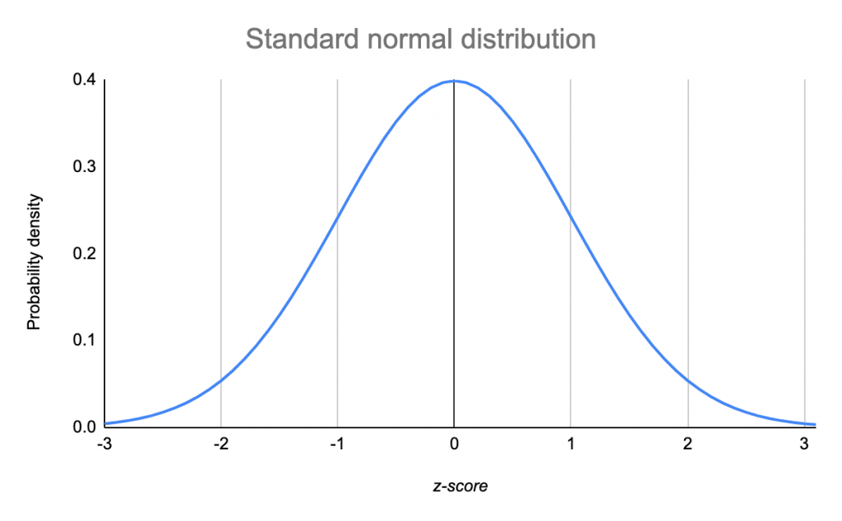
So far we have assumed a Normal distribution
Response is continuous
  Ranges from –infinity to + infinity
2 parameters describes the curve
  Mean = µ
  Variance = σ²
  Variance independent of the mean i.e. different data sets with the same mean can have different variance.

Slide 39
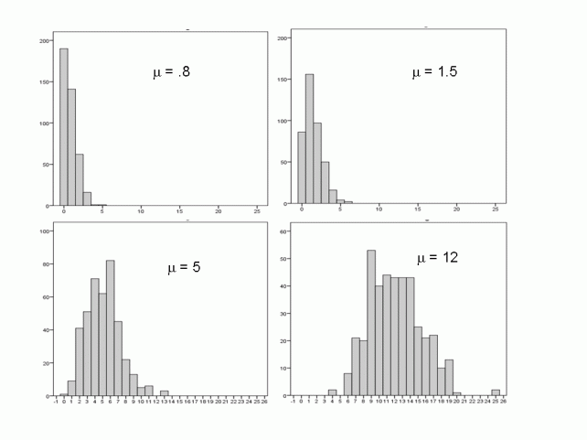
BUT, what if it was different, say count data?
Could use the Poisson distribution instead
Response is discrete
  Often used for counts
  Ranges from 0 to + infinity
1 parameter describes the curve
  Mean = variance = λ (lamba) i.e. different data sets with same mean have to have the same variance
  Variance gets bigger as mean does. Which makes sense since larger counts can have larger variance.

Slide 40
Different Data Distributions
The Data Distribution
Part 2 of the 3 required for a GLM
Common Distributions
Normal Distribution for unbounded continuous data
Poisson for count, rate, positive integer and some log normal data
Binomial for binary data i.e. logistic regression

Slide 41
Adding Transformations using the Link function
Expand this section with examples of log models
And a better formal explanation of how the link function is defined
So far we have established that Y_{i} = η_{i} + ε_{i} can be used to efficiently represent all types of linear models.
But what if we also want to transform the response e.g. a very common transformation is to take its logarithm so we now have
Log(Y_{i}) = η_{i} + ε_{i}
This is called the link function in a GLM.
(A more formal way to represent it is E(Y|X) = µ = g⁻¹(η) where g is the link function.)
The Link Function
Part 3 of the 3 required for a GLM
TAKE HOME
Link function allows us to effectively transform the response

Slide 42
Log links also allow us to change the additive linear predictor into a multiplicative model
Y_{i} = β_{ο}X_{0i} + β₁X_{1i} + β₂X_{2i} + β₃X_{3i} + ….. + ε_{i}
= η_{I} + ε_{i} = linear predictor + ε_{i}
= linear/additive model
Y_{i} = β_{ο}X_{0i} x β₁X_{1i} x β₂X_{2i} x β₃X_{3i} ….. + ε_{i}
= multiplicate model
More info and examples to come. For now just take in that GLM’s can use link functions, such as the log link, to ‘convert’ the linear predictor which is additive from an additive to a multiplicative model. This is how Poisson or Logistic regression become multiplicative, not additive, models.
ADD some background slides and references on how the log link creates a multiplicative model
https://www.theanalysisfactor.com/count-models-understanding-the-log-link-function/
Notes:
TO DO is multiplicative it + or * e

Slide 43
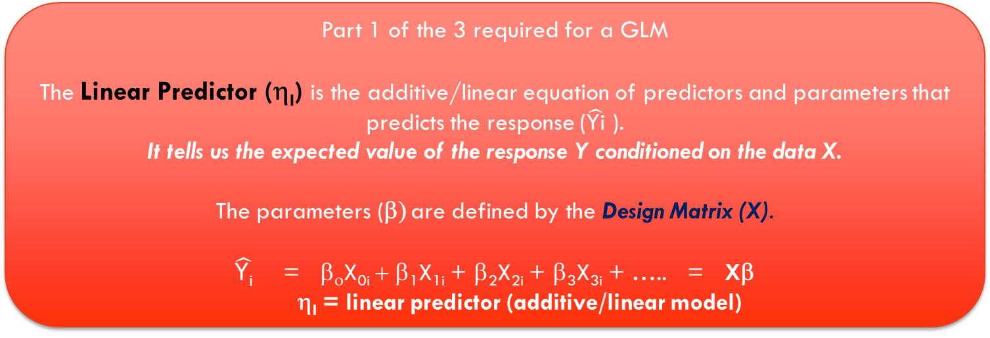
GLM components
Part 1 of the 3 required for a GLM
The Linear Predictor (η_{I}) is the additive/linear equation of predictors and parameters that predicts the response ($\hat{\text{Yi}}$ ).
It tells us the expected value of the response Y conditioned on the data X.
The parameters (β) are defined by the Design Matrix (X).
$\hat{\text{Y}\text{i}}$ = β_{ο}X_{0i} + β₁X_{1i} + β₂X_{2i} + β₃X_{3i} + ….. = Xβ
η_{I} = linear predictor (additive/linear model)
Part 2 of the 3 required for a GLM
Different Data Distributions
Part 3 of the 3 required for a GLM
The Link Function is a way to add transformations and make the model multiplicative.

Slide 44


Slide 45
So let’s look at how these 3 things work together to let us model a wide range of data types
Worked on this in version 2.14, need to review!
Notes:
BAD FROM HERE ON!!

Slide 46
But first: some new notation that succinctly represents a GLM
Let’s start with the simple linear model:
Y_{i} = β_{ο} + β₁X_{1i} + ε_{i}
If Y is normally distributed than we can represent it using this notation:
Y_{i} ~ N(μ, σ²), where:
μ ~ average
σ² ~ variance
Notes:
But let’s make that a bit more concise.
It will also help us generalise this to other types of models. We’re going to come back to this in a second.

Slide 47
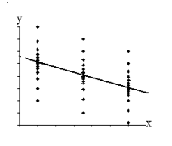
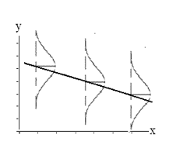
But first: some new notation that succinctly represents a GLM
Y_{i} ~ N(μ, σ²), where
The variance (σ² ) is constant.
However, Y’s average (μ) comes from the model line.
We predict the average (μ) for any combination of predictors (X) using our model.
Or in other words we say the average (μ) is conditional on the predictors.
Which we can write as μ= β_{ο} + β₁X_{1i}
These plots show how the distribution for any prediction of X is based on the line i.e. model, while the error is normally distributed about the line.
Notes:
But let’s make that a bit more concise.
It will also help us generalise this to other types of models. We’re going to come back to this in a second.

Slide 48
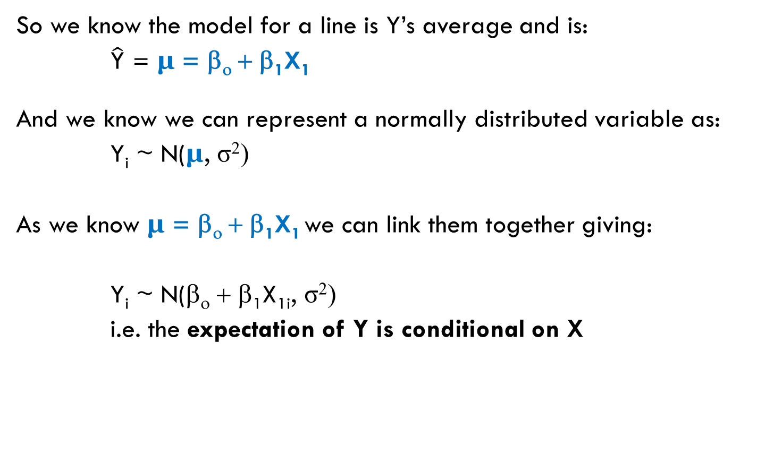
But first: some new notation that succinctly represents a GLM
So we know the model for a line is Y’s average and is:
$\hat{\text{Y}}$ = μ = β_{ο} + β₁X₁
And we know we can represent a normally distributed variable as:
Y_{i} ~ N(μ, σ²)
As we know μ = β_{ο} + β₁X₁ we can link them together giving:
Y_{i} ~ N(β_{ο} + β₁X_{1i}, σ²)
i.e. the expectation of Y is conditional on X
Notes:
But let’s make that a bit more concise.
It will also help us generalise this to other types of models. We’re going to come back to this in a second.

Slide 49
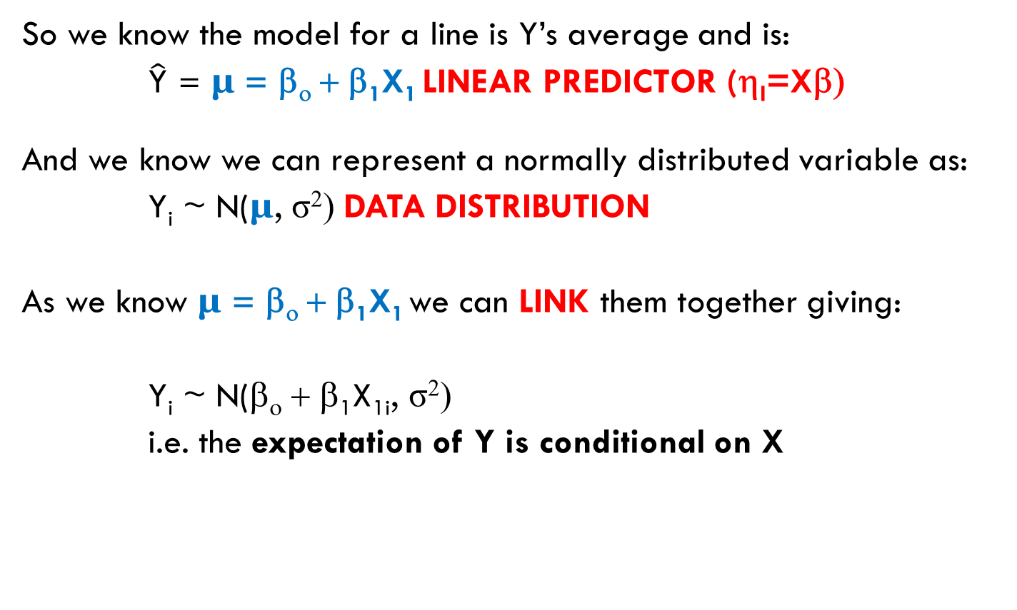
But first: some new notation that succinctly represents a GLM
So we know the model for a line is Y’s average and is:
$\hat{\text{Y}}$ = μ = β_{ο} + β₁X₁ LINEAR PREDICTOR (η_{I}=Xβ)
And we know we can represent a normally distributed variable as:
Y_{i} ~ N(μ, σ²) DATA DISTRIBUTION
As we know μ = β_{ο} + β₁X₁ we can LINK them together giving:
Y_{i} ~ N(β_{ο} + β₁X_{1i}, σ²)
i.e. the expectation of Y is conditional on X
Notes:
But let’s make that a bit more concise.
It will also help us generalise this to other types of models. We’re going to come back to this in a second.

Slide 50
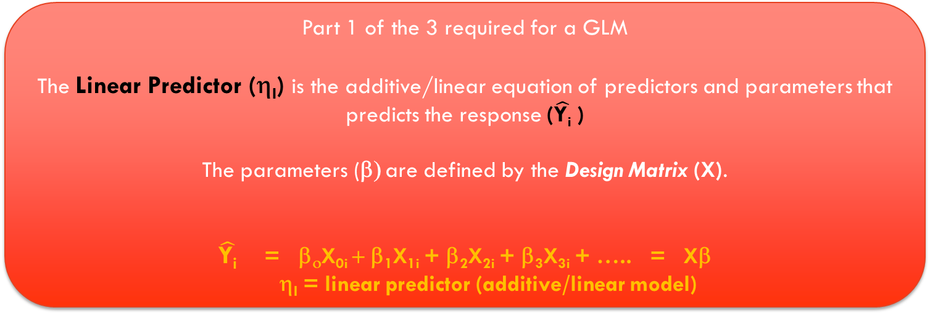
GLM components
Part 1 of the 3 required for a GLM
The Linear Predictor (η_{I}) is the additive/linear equation of predictors and parameters that predicts the response ($\hat{\text{Y}\text{i}}$ )
The parameters (β) are defined by the Design Matrix (X).
$\hat{\text{Y}\text{i}}$ = β_{ο}X_{0i} + β₁X_{1i} + β₂X_{2i} + β₃X_{3i} + ….. = Xβ
η_{I} = linear predictor (additive/linear model)
Part 2 of the 3 required for a GLM
Different Data Distributions such as Y_{i} ~ N(μ, σ²)
Part 3 of the 3 required for a GLM
The Link Function μ = β_{ο} + β₁X is a way to add transformations and make the model multiplicative AND link Part 1 and 2 together Y_{i} ~ N(β_{ο} + β₁X_{1i}, σ²) .

Slide 51
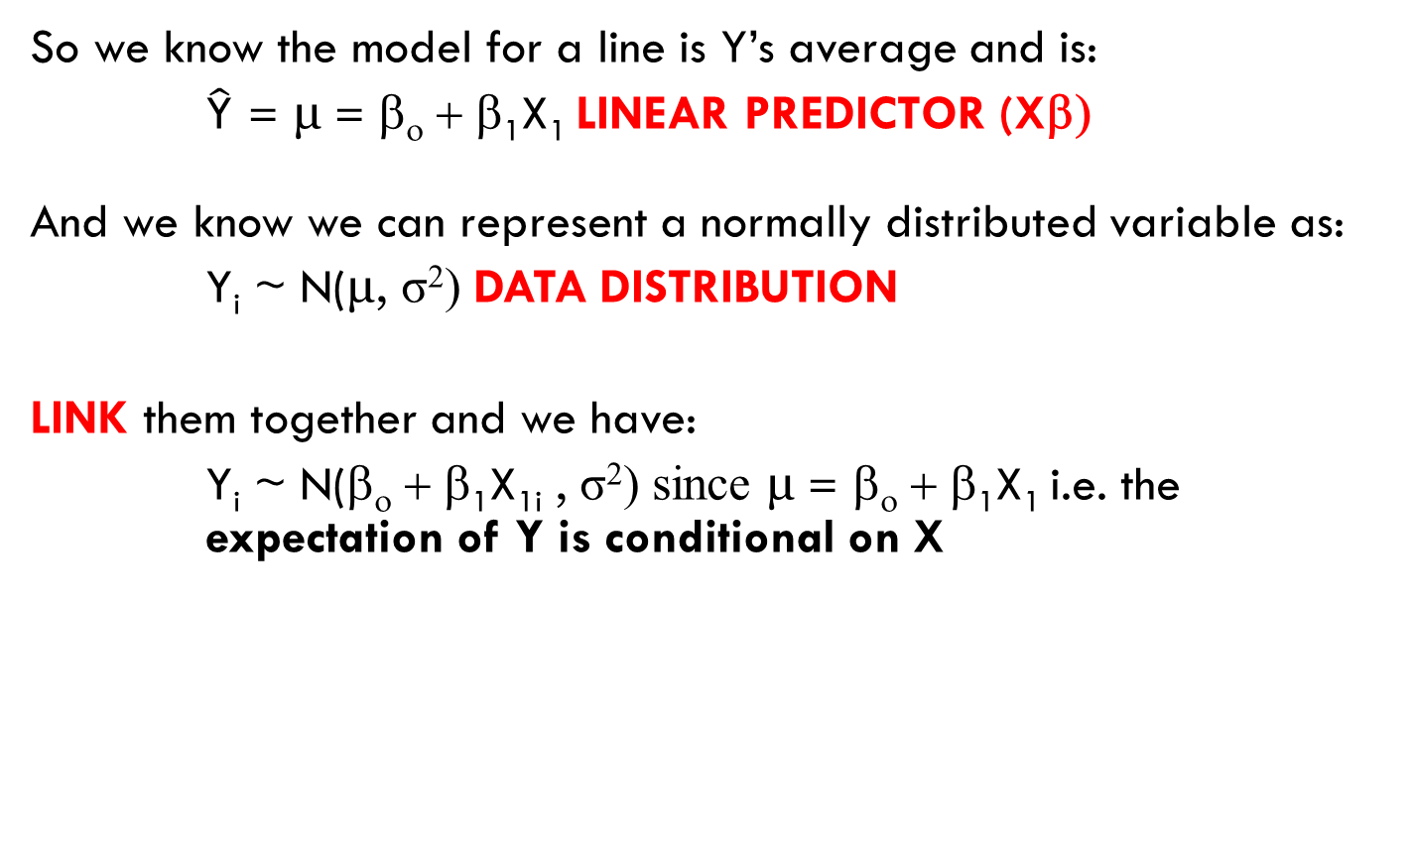
Challenge Q: What do we change if the Error was Poisson instead of Normal?
So we know the model for a line is Y’s average and is:
$\hat{\text{Y}}$ = μ = β_{ο} + β₁X₁ LINEAR PREDICTOR (Xβ)
And we know we can represent a normally distributed variable as:
Y_{i} ~ N(μ, σ²) DATA DISTRIBUTION
LINK them together and we have:
Y_{i} ~ N(β_{ο} + β₁X_{1i} , σ²) since μ = β_{ο} + β₁X₁ i.e. the expectation of Y is conditional on X
Notes:
But let’s make that a bit more concise.
It will also help us generalise this to other types of models. We’re going to come back to this in a second.

Slide 52
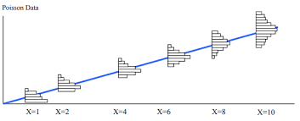
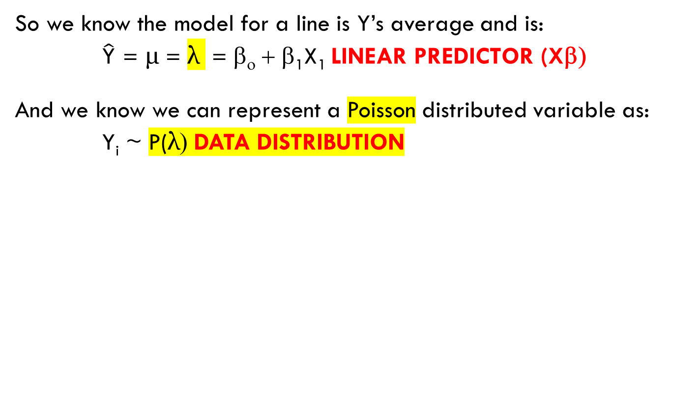
Challenge Q: What do we change if the Error was Poisson instead of Normal?
So we know the model for a line is Y’s average and is:
$\hat{\text{Y}}$ = μ = λ = β_{ο} + β₁X₁ LINEAR PREDICTOR (Xβ)
And we know we can represent a Poisson distributed variable as:
Y_{i} ~ P(λ) DATA DISTRIBUTION
Notes:
But let’s make that a bit more concise.
It will also help us generalise this to other types of models. We’re going to come back to this in a second.

Slide 53
Challenge Q: What do we change if the Error was Poisson instead of normal?
So we know the model for a line is Y’s average and is:
$\hat{\text{Y}}$ = μ = λ =β_{ο} + β₁X₁ LINEAR PREDICTOR (Xβ)
And we know we can represent a Poisson distributed variable as:
Y_{i} ~ P(λ) DATA DISTRIBUTION
LINK them together using a log link and we have:
Y_{i} ~ P($e^{\text{b}\text{o}\text{ + }\text{b}\text{1}\text{X}\text{1}}$) since log(μ) = λ i.e. μ = $e^{\text{λ}}$
Notes:
But let’s make that a bit more concise.
It will also help us generalise this to other types of models. We’re going to come back to this in a second.

Slide 54

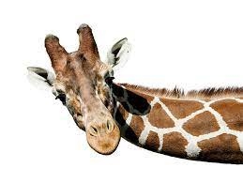
Congratulations. You just developed Generalised Linear Models from 1st principles!
Notes:
So if you land on some alien world you can now give them the gift of GLM’s!!

Slide 55
So let’s take a breath and tie all that together into a concise summary you can come back to

Slide 56
Simple Linear Model (topic of LM1 workshop)
Y_{i} = Xβ + ε_{i}
= Deterministic model + Random model
~ N(μ, σ²) where μ= Xβ i.e. assumes a Normal error
Can be used to fit any of these models
1 continuous predictor (simple linear regression)
Multiple continuous predictors (multiple regression)
Discrete predictors (ANOVA, RCT, BACI, Control/Treatment)
Discrete + continuous predictors e.g. ANCOVA is a special case
The only difference between them is the Design Matrix X from Xβ!

Slide 57
GLM’s are a simple extension of Simple Linear models
SIMPLE LINEAR MODEL
Y_{i} = Xβ + ε_{i}
= Deterministic model (Xβ) + Random model (ε_{i})
~ N(μ, σ²) where μ= Xβ i.e. assumes a Normal error
~ Gives us a simple, single, unified way of fitting all types of continuous and discrete predictors so we can fit different models like regression, ANOVA, ANCOVA, BACI, RCT, Control/Treatment, etc. It does this by using a design matrix X with different design variables.
~ (also known as General Linear Models – as opposed to Generalised Linear Models)
GENERALISED LINEAR MODEL (GLM)
Can fit all the same models as a Simple Linear Model PLUS it:
  Uses the linear predictor to concisely represent the many different designs
  Generalises the model so we can use non normal errors/distributions
  Adds inbuilt response transformations via the link function
Notes:
TO DO is it + or * e

Slide 58
GLM’s are a simple extension of Simple Linear models with 3 parts
Improve this definition
MAKE IT MORE FORMALLY CORRECT
AND ALIGNED with the 3 GLM parts take home boxes
Xβ = η
  Deterministic model: which is the linear predictor that relates the predictors to the response.
  Notice the Design Matrix X, is the same as in the simple linear model. This lets us fit all the models we are used e.g. ANOVA, BACI, RCT, etc, but with a different error/distribution.
Y_{i} ~ N(μ, σ) or Poisson(μ) or Binomial(μ) or etc
  Random model: which is the distribution of the data conditional on the expectation e.g. my response is normally distributed with average μ.
μ = g(η) = g(Xβ)
  The link function (g) which links the linear predictor η = Xβ with the response via it’s distribution and conditional expectation.

Slide 59
The 3 most common GLM’s
Simple Linear Models e.g. simple linear regression and ANOVA
Y_{i} ~ N(μ, ${\text{σ}}^{2}$) where μ=Xβ
Poisson (count) Model ~ also used for rates and concentrations (refer to it’s example below)
Y_{i} ~ Poisson(μ) where log(μ)=Xβ
Logistic (binary) Model
Y_{i} ~ Binomial(μ) where logit(μ)=$\ln{\frac{\text{p}}{\text{1−}\text{p}}}=$Xβ (since the probability, p, is just the mean of the Y values, assuming 0,1 coding, which is often expressed as µ)

Slide 60

45
Notes:
Any Questions???

Slide 61
Logistic Regression example 1
Binary Response e.g. yes/no, success/failure, 0/1
Workflow Suitable for:
Continuous predictor

Slide 62
Logistic/Binary Regression
Used when we have a categorical response than can be 1 of 2 categories. We usually code them as:
1 = Success
0 = Failure
Tells us which predictors are positively and negatively correlated with more Successes. To make the output easy to understand the trick is defining the ‘success’ group.
Medical: We usually define the disease as the ‘success’ since we want to know what influences getting it.
Churn: Could be either the people who left or stayed, depending on who we want to focus on.
Loan Defaults: Defaulters would usually be the ‘success’ group since we want to know why people default.
Notes:
Add: politics, purchase, etc

Slide 63
Similar to Survival Analysis
When deciding which to use consider the data available and Research Question:
Logistic Regression models the probability (chance) of an event occurring
Survival Analysis models the probability (chance) of an event occurring and the time to that event
The main differences are that Survival Analysis:
Factors in time to the Event/Success and gives you survival curves. There is an important distinction between living for 6 months vs 6 years after diagnosis! Logistic treats them the same (unless time to death is explicitly added).
Can handle data where the event happens for everyone i.e. everyone dies.
Factors in patients lost to follow up (censoring)
Uses Hazard Ratios instead of Odds Ratio.
  These are the ratio of 2 hazards. Hazards are the instantaneous rate of the event (e.g. death or failure) given an individual has survived up to that time (T), they are also the slope/tangent of the survival curve at time T. For a hazard ratio to be a consistent and hence good estimate of 2 hazards over a time interval they need to be proportional over this time period i.e. the slopes need to be parallel, which is why predator this assumption is often called the Parallel Lines assumption.
Naturally handles time varying covariates (since it naturally includes time to event while logistic regression does not).
  Logistic regression factors in time as an additional predictor. A categorical predictor gives us different parameters/logit curves e.g. event occurred at 6 months vs 6 years, or continuous e.g. covariate adjustment parameter of Beta. Covariates that then vary by time can be added as interactions to the time predictor.
Refer to our Survival Analysis workshop for more information.

Slide 64
Model Fitting Workflow
Step 0) Clean and check data.
Step 1) Pick a suitable model to fit to the data via Exploratory Data Analysis (EDA).
Step 2) Fit the Model
Step 3) Check Model Assumptions via Diagnostics: Residual Analysis
Step 4) Goodness of Fit: Plots and Statistics
Step 5) Interpret Model Parameters and reach a conclusion
Step 6) Reporting
Linear Models 3 and Model Building Workshops have more detail on many of these steps.

Slide 65
Step 0) Clean and check data
Is covered in “Research Essentials”, not this workshop.
Is very important, so ensure you do it!
Get in the habit of checking the data every time you open it by looking at the corners i.e. start at the top left corner, then scroll to the far right corner, scroll down to the bottom right corner, scroll left to the bottom left corner, then finish by scrolling pack up to the beginning top left corner.
  Weird things can happen. New versions, a stray cosmic ray. I have literally opened data to find it corrupted, and then reopened it and it’s fine. Similarly I have seen weird results only to rerun them to find them OK.

Slide 66
Step 1) Pick a suitable model to fit to the data via Exploratory Data Analysis (EDA).
Challenge Question: We have done a case control study. We got 100 people with lung cancer and 500 people without. How would you plot the response variable?
Our response has 2 options. There are no outliers or NA’s.
So it’s not appropriate for a Simple Linear Regression with a Normal error. No way the error will be normal with only 2 responses.
BUT it’s a good contender for Logistic/Binary
Regression.
> plot(cc1$"lung cancer")

Slide 67
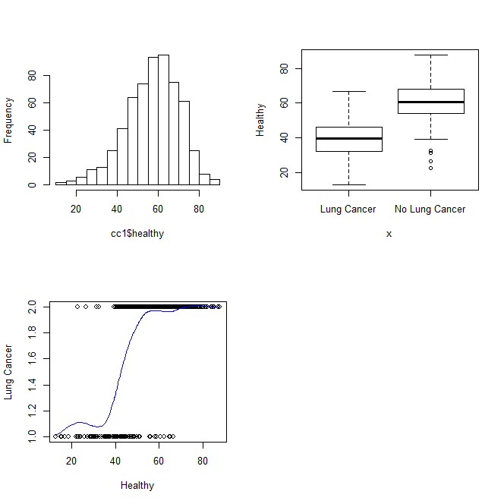
Step 1) Pick a suitable model to fit to the data via Exploratory Data Analysis (EDA).
Now add the continuous predictor “healthy lifestyle” which is an index based on things like exercise, food, sleep, etc. It ranges from 0 = unhealthy to 100 = healthy. How might it be related to lung cancer?
All 3 plots tells us there are no outliers or other data problems with “Healthy”.
The boxplot and scatterplot show us there is a relationship between healthy and lung cancer.
The sigmoid slide is confusing. I need to label it with Smoking vs non smoking instead of 1 and 2.
> windows()
> par(mfrow=c(2,2))
> hist(cc1$healthy, main="")
> plot(cc1$`lung cancer`, cc1$healthy, ylab="Healthy")
> plot(cc1$healthy, as.numeric(cc1$`lung cancer`), ylab="Lung Cancer", xlab="Healthy")
> lines(smooth.spline(cc1$healthy, as.numeric(cc1$`lung cancer`)), col="blue", ylab="Lung Cancer",
xlab="Healthy")
In vertical axis: 1 = Lung Cancer, 2 = No Lung Cancer. Had to convert to numbers and not label with the text in order to get the smoothed blue line.

Slide 68
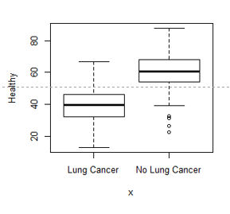
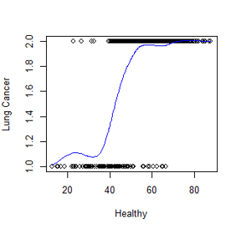
Step 1) Pick a suitable model to fit to the data via Exploratory Data Analysis (EDA).
This plot show the health indices average difference between those with and without lung cancer. Its quantified using an ANOVA like we did in LM1.
It allows us to predict the health index score knowing if someone has lung cancer.
This plot shows the relationship between the health index and getting lung cancer. It is quantified using logistic regression.
It allows us to predict the chance of having lung cancer if we know their health score.
The sigmoid slide is confusing. I need to label it with Smoking vs non smoking instead of 1 and 2.

Slide 69
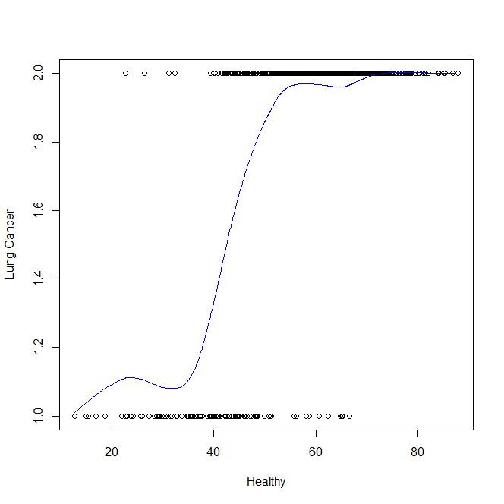
Step 1) Pick a suitable model to fit to the data via Exploratory Data Analysis (EDA).
Notice that the relationship between healthy and Lung Cancer isn’t linear. It’s more of an S shape.
This relationship is called a sigmoid function, and is what logistic regression fits.
But how do we fit this using a linear model?
The trick is the link function in a GLM.
Which lets us fit non linear models.
The sigmoid slide is confusing. I need to label it with Smoking vs non smoking instead of 1 and 2.

Slide 70
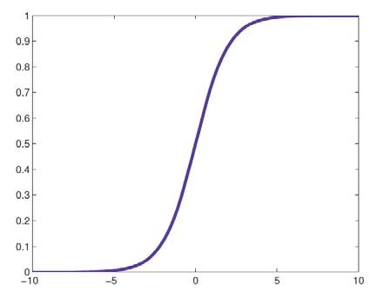
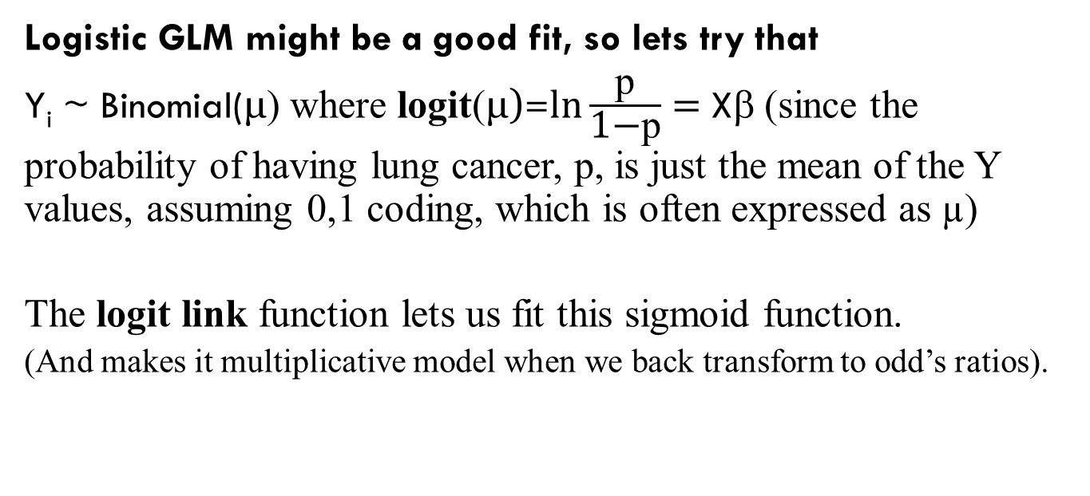
Step 1) Pick a suitable model to fit to the data via Exploratory Data Analysis (EDA).
Logistic GLM might be a good fit, so lets try that
Y_{i} ~ Binomial(μ) where logit(μ)=$\ln{\frac{\text{p}}{\text{1−}\text{p}}}=$Xβ (since the probability of having lung cancer, p, is just the mean of the Y values, assuming 0,1 coding, which is often expressed as µ)
The logit link function lets us fit this sigmoid function.
(And makes it multiplicative model when we back transform to odd’s ratios).
SIGMOID FUNCTION
And here I need to show how the labels are actually modelled using the numbers 0 and 1. Since models can model text.

Slide 71
Step 1) If we had categorical variables such as smoking
We also need to look for Separation.
Complete Separation occurs when we have cells that are entirely success or failures e.g. if we had included smoking perhaps all the smokers got lung cancer. This is an example of where smoking has separated the response. The model can not fit when this happens and is one common reason for logistic models not converging (since its effectively trying to divide by 0).
Separation often causes error messages like “failed to converge”, warning messages like “! glm.fit: fitted probabilities numerically 0 or 1 occurred” or high parameter SE’s.
Even if we don’t have complete separation, marginal separation can still cause problems.
 | Lung Cancer | No Lung Cancer
Smoker | 100 | 0
Non Smoker | 10 | 800
 | Estimate | SE
Constant | 7.9 | 0.06
Smoker | 1000 | 597000

Slide 72
Step 2) Fit the Model
cc.model <- glm(lung.cancer ~ healthy, data=cc2, family=binomial)
“Success” = Having Lung Cancer, meaning the parameters tell us what risk factors there are for getting cancer.

Slide 73
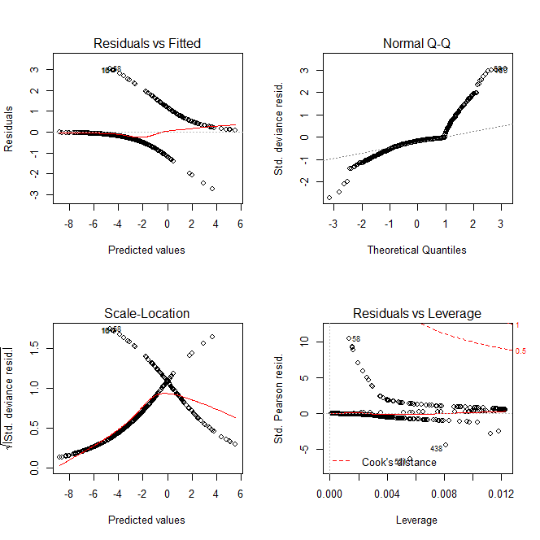
Step 3) Check Model Assumptions via Diagnostics: Residual Analysis
The standard residual plots don’t help much here since we don’t expect normal residuals and as we only have 2 responses we get these 2 lines in the residual plots.
However, they can be used to look for
Outliers.
Dharma residuals are more useful
and are in the R workflow which can
be downloaded from our online
library.
> windows()
> par(mfrow=c(2,2))
> plot(cc.model)

Slide 74
Step 3) Check Model Assumptions via Diagnostics: Is there any Over Dispersion?
One of the problems we have is that the Binomial Distribution has no separate variance parameter.
The Normal distribution has 2 parameters. The mean (μ) and the variance (σ).
However, the Binomial Distribution only has 1 parameter: p~the probability of an event occurring. Its average and variance are both functions of this single parameter. But sometimes we have more variance than the distribution can handle.
There are some complications on how we handle this for logistic regression which are beyond the scope of this workshop. However we mention it here so you are aware.

Slide 75
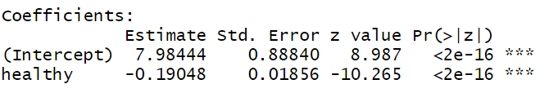
Step 4) Goodness of Fit: Are any parameter SE’s too high?
It’s always a good idea to look at the parameter SE’s to see if any are a lot higher than the others. This can be a sign of a variety of problems. At the very least they suggest the estimate for this parameter is very unstable. The below is for our model and doesn’t suggest any problems.
BUT the below does might, notice SE is an order of magnitude larger than estimate i.e. times 10/add a zero. Often caused by separation, which we hopefully identified during the EDA. However marginal separation can be hard to identify, particularly if we are fitting a lot of 2 way interactions with a lot of cells.
Coeffects:
Estimate Std. Error
(Intercept) 7.9844 88.840
Healthy -0.19048 1.856
# Some of the R output available from
> summary(cc.model)

Slide 76
Step 4) Goodness of Fit: Are any parameter SE’s too high?
As previously mentioned during the EDA stage (and copied below) a large SE can be a sign of Separation.
Complete Separation occurs when we have cells that are entirely success or failures e.g. if we had included smoking perhaps all the smokers got lung cancer. This is an example of where smoking has separated the response. The model can not fit when this happens and is one common reason for logistic models not converging (since its effectively trying to divide by 0).
Separation often causes error messages like “failed to converge”, warning messages like “! glm.fit: fitted probabilities numerically 0 or 1 occurred” or high parameter SE’s.
Even if we don’t have complete separation, marginal separation can still cause problems.
 | Lung Cancer | No Lung Cancer
Smoker | 100 | 0
Non Smoker | 10 | 800
 | Estimate | SE
Constant | 7.9 | 0.06
Smoker | 1000 | 597000

Slide 77
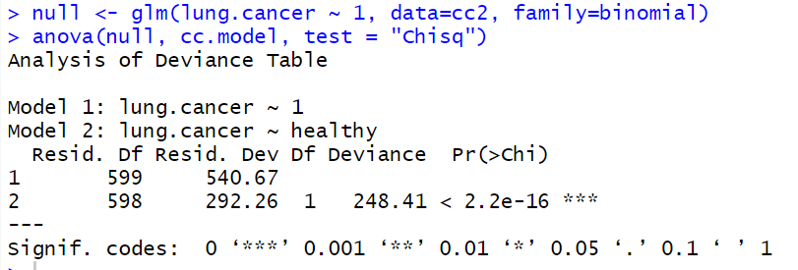
Step 4) Goodness of Fit: Compare it to the NULL model
It’s always worth comparing any model to the NULL model, which is the model without any predictors and only a constant/intercept.
In this case we have strong evidence that our model is outperforming the NULL model (P<2.2e-16).
The test used is a Likelihood Ratio Test (LRT), if the models are nested and have the same data. One drawback is that the LRT makes the asymptotic assumption that the chi-square distribution approximates the null distribution of likelihoods. In other words, at small sample sizes it may not be particularly accurate. As such the F test (which is s a specific type of LRT) might be better if the error is normal and sample sizes small - as it doesn’t require the LRT asymptotic assumption since it’s the actual ratio of 2 chi-squared variables. https://stats.stackexchange.com/questions/120309/low-sample-size-lr-vs-f-test and https://stats.stackexchange.com/questions/535709/anova-vs-likelihood-ratio-test-different-result

Slide 78
Step 4) Goodness of Fit: What is it’s (Pseudo) R-Squared?
Technically there is no R-Squared for a GLM, however there is an equivalent based on the % Deviance explained. This is one type of Pseudo R-Squared.
Which in this case is acceptable, at 45%

Slide 79
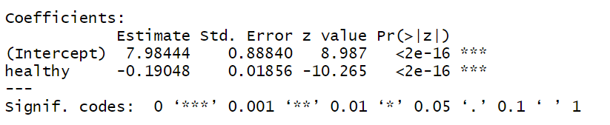
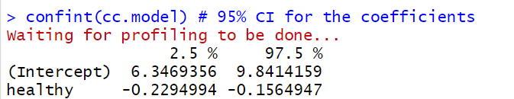
Step 5) Interpret Model Parameters and reach a conclusion
For Simple Linear models we can simply look at the parameter estimate summary and CI’s. BUT in logistic regression these are hard to interpret as they are still on the logit scale.
The only really useful part of this ‘raw’ output is the p-value associated with the parameters. Which in this case shows strong evidence of being associated with healthy (p<2e-16)
# Some of the R output available from
> summary(cc.model)

Slide 80
Step 5) Interpret Model Parameters and reach a conclusion - Using Odds Ratios (OR)
The parameters can be made more interpretable by taking their exponential since this turns them into odds ratios (which will be explained shortly).
Taking the exponential is similar to taking something to the power10. But instead of 10 we use the constant e = exp = 2.718, which is the inverse of the natural logarithm function (ln) we used in the link function.
Don’t overthink it!! You don’t need to know why we use an exp, just accept and use it!
For an example, as our coefficient is -0.19 if we took it to the power 10 we would get 10^{-0.19048} = 0.65, but instead we do 2.718^{-0.19048} = e^{-0.19048} = exp(-0.19048) = 0.83.

Slide 81
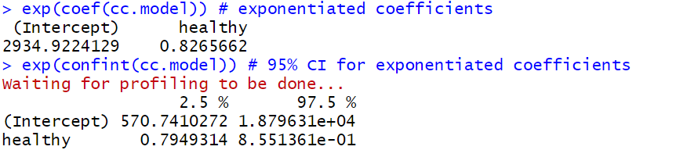
Step 5) Interpret Model Parameters and reach a conclusion - Using Odds Ratios (OR)
We get the below OR=0.83 for the continuous variable Health, which tells us that for each 1 point increase on the Health index the odds of getting lung cancer are 0.8 compared to the lower score (95%CI = 0.79-0.86).
So being healthy lowers the odds of getting lung cancer!

Slide 82
Step 5) Interpret Model Parameters and reach a conclusion
Parameter | Estimate (raw) | SE (raw) | T score (raw) | P value (raw) | 95% Confidence Interval Exp(β) i.e. odds ratio
 |  |  |  |  | Estimate | Lower Bound | Upper Bound
Constant / Control (β_{ο}) | 8.0 | 0.89 | 9.0 | <2e-16
Health index (β1) | -0.19 | 0.019 | -10 | <2e-16 | 0.83 | 0.79 | 0.86

Slide 83
Step 6) Reporting: Overall Conclusion suitable for publication
“There is strong evidence to show that being healthy is associated with lower odds of Lung Cancer (p<2e-16). For each 1 point increase on the Health index the Odds of getting lung Cancer are 0.8 compared to the lower score (95%CI odds ratio = 0.79-0.86). This effect on lung cancer has been estimated very accurately [as 95% CI is quite narrow].
The model is an acceptable fit to the data with a pseudo R²=45%. There were no outliers or unexplained structure.
The model fit was a GLM with binomial distribution and logit link function”
When giving a p-value always give an estimate of the effect size as well i.e. the 95% CI.

Slide 84
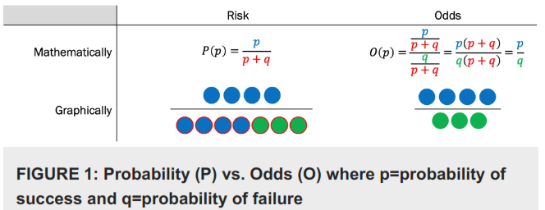
So what exactly is an Odds Ratio (OR)?
It’s best described with an example.
Say the OR for smoking on whether you get lung cancer is 3. This means the odds of getting lung cancer if you smoke is 3 times the odds of getting it if you don’t smoke. In other words, an odds ratio is the ratio of two odds.
And what is an “odds”? The odds of something happening is related to its probability, but isn’t the same.
Say the probability/chance/risk of getting lung cancer if you smoke is 75%. Then the corresponding odds are p/(1-p)=75/25 = 3:1 = 3. These are obviously different numbers with different interpretations, which is why odds ratios can be used to comment on the odds of something occurring, not its probability, chance or risk.
You would have seen it in horse racing too e.g. if Phar Lap tends to win 19 out of 20 races than the odds of Phar Lap winning are 19:1 = 19/1 = 19. On the other hand, the probability of Phar Lap winning is 19/20 = 95%.
Risks report the # of events in relation to the # of trials i.e. # events vs # trials.
Odds report the # of events in relation to the # of nonevents i.e. # events vs # nonevents.
Figure from George A, Stead TS, Ganti L. What's the Risk: Differentiating Risk Ratios, Odds Ratios, and Hazard Ratios? Cureus. 2020 Aug 26;12(8):e10047. doi: 10.7759/cureus.10047. PMID: 32983737; PMCID: PMC7515812.

Slide 85
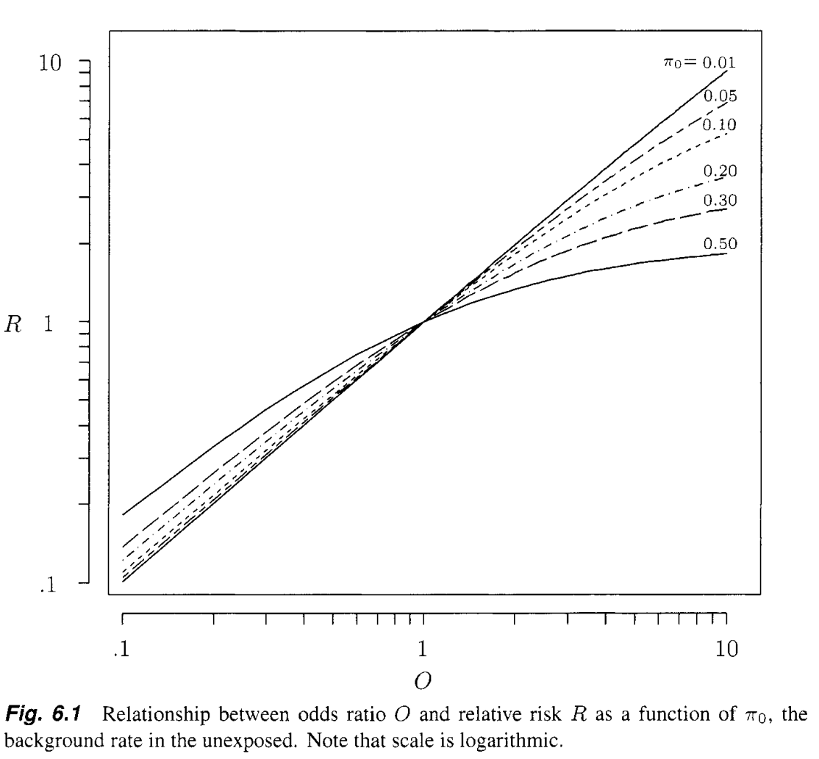
Odd Ratios (OR) are different to the Relative Risk (RR)
Relative Risk (RR) is the ratio (relative difference) of probabilities. The Odds Ratio (OR) is the ratio (relative difference) of odds. Meaning they have different interpretations so be careful what language you use when communicating results.
If the OR of smoking on getting lung cancer is 3, then you need to say the odds of getting lung cancer if you smoke is 3 times the odds of getting it if you don’t smoke.
If the RR of smoking on getting lung cancer is 3, then you need to say the chance of getting lung cancer if you smoke is 3 times the chance of getting it if you don’t smoke.
Incorrectly interpreting ORs as RRs can exaggerate the impact as ORs underestimate the RR when both are <1 and overestimate it when >1.
Gerald van Belle (2008) Statistical Rules of Thumb

Slide 86
Expert Trick 1) Interpreting Odds Ratios (OR) as Relative Risks (RR) using the rare disease assumption
The medical literature commonly interprets odds ratios from logistic regression as relative risks.
This is because when an event is ‘rare’ odds ratios approximate relative risks. The plot below shows that when the incidence is 1% the OR and RR closely follow the 1:1 equivalence line, but become different very quickly as one moves away from 1when the incidence is as low as 5% (plot is from Gerald van Belle (2008) Statistical Rules of Thumb).
So, although some authors say 10% is rare enough. I disagree and would suggest 1% is the maximum. However, it is a subjective decision and if you are unsure then just report and interpret as an odds ratios.
There are other complications as well e.g. this assumption usually can’t be applied to case control studies meaning they always need to report odds ratios irrelevant to how small the incidence is. So before interpreting OR as RRs it’s a good idea to read up on it, a good place to start is Gerald van Belle (2008) Statistical Rules of Thumb (which is where the plot on the left comes from).

Slide 87
Why OR underestimates the RR when both are <1 and overestimates it when >1
Because if we have p + q trials when we reduce p this means q has to increase. But this only impacts the numerator in the risk. While both the odds numerator and denominator are affected in opposite directions, so it falls faster. Similarly, if p increases the OR increases quicker.
George A, Stead TS, Ganti L. What's the Risk: Differentiating Risk Ratios, Odds Ratios, and Hazard Ratios? Cureus. 2020 Aug 26;12(8):e10047. doi: 10.7759/cureus.10047. PMID: 32983737; PMCID: PMC7515812.
Gerald van Belle (2008) Statistical Rules of Thumb

Slide 88
It’s a multiplicative model, not an additive one
Given the odds of getting lung cancer drop by 0.8 for a 1 point increase in health. What impact does a 2 point increase in health have?
Would it be 0.8 + 0.8 = 1.6 (additive)?
Can’t be this, since it goes from dropping the odds of lung cancer (<1) to increasing them (>1)!
Or 0.8 * 0.8 = 0.64 (multiplicative)?
This makes more sense as a 2 point increase in health leads to a lower chance of lung cancer than a 1 point increase.
This is what the log link (transformation) does. It turns the additive linear predictor which is an additive model without a log link, into a multiplicative model when it has one.
So to calculate the odds ratio for k intervals of difference in the health predictor it’s 0.8^{k} for this example or β^{k} in general e.g. if we wanted the odds ratio for a continuous predictor that moved from 5 to 10 it would be β⁵.
  Notice that this is for any difference in the predictor. The impact is the same if its 5 vs 10 or 100 vs 105, since both are a 5 interval difference.
ADD equation here and how the log link makes it multiplicative as a reference slide only!!!

Slide 89
Expert Trick 2: Interpreting fractional OR and when swapping the response events success/fail definition is helpful
Let’s continue the previous lung cancer example where smoking's OR was 3 – which means smokers have 3 times the odds of getting lung cancer than non-smokers.
If we changed the response reference category from having cancer to not having cancer than it makes sense for smoking’s OR to now be the reciprocal of what it was before i.e. 1/3=0.33 - since this now means that smoker’s have 1/3 = 33% the odds of not having lung cancer than non-smokers.
This is the same result, just expressed differently. Which makes sense since our conclusions shouldn’t differ based on the arbitrary decision on what to make the reference response category. Mathematically it shouldn’t affect the results.
The same thing occurs if one swaps the predictors event definitions around (but for slightly different reasons).
This is a handy trick to know since fractional odds ratios i.e. OR < 1, can be hard to interpret and communicate. So if you have a lot of hard to communicate OR < 1 just swap how you have defined the responses ‘success’ event and now they will all be greater than 1! (with the OR > 1 now less than 1).
You can also swap the response event, or predictor events, to make the interpretation easier. For example, double negatives when both are negative can be hard to interpret.

Slide 90
Interpreting fractional OR and when swapping the response events success/fail definition is helpful
Mathematically this happens for the response because the odds of an event happening is the reciprocal of the odds that it didn’t happen i.e. if the odds(event A happening) = X than the odds(event A not happening) = 1/X.
For example, if we have a logistic regression where we define event A as the success, and this results in a predictors OR being 1/3=0.33
Then if we swap response events and make event A the failure each odds within the odds ratio is inverted within themselves making the OR it’s reciprocal which is 1/0.33 = 3
On the other hand, if we swap the predictors then we are swapping the numerator and denominator odds in the odds ratio.

Slide 91
Expert Trick 3) Consider reporting absolute measures such as probabilities/risks, odds and % of sample too
ORs compare the relative change in the odds, but ignore the underlying absolute chance of an event happening. It’s important to know both.
Example 1: Low absolute chance of event. Say eating avocados increases the odds of a rare cancer by 10 i.e. OR=10. But the baseline odds of getting the rare cancer is 0.0000000000000000000000000000001. Increasing the odds by 10 has little practical impact on the chance of getting cancer, so keep eating avocados! (Especially considering their other health benefits).
Example 2: Different ORs can have very different baseline chances. The below might show the % of people who got a dash of cabin fever during the COVID lockdowns of 2020. From 2 studies, one done in Melbourne (which had strict lockdowns) and 1 in Cairns Qld (who were largely unaffected)
As you can see the odds ratio is the same, people with kids were more likely to be affected (I wonder why??).
However. Far more people in Melbourne were affected than in Cairns, as expected.
So, when reporting it can be useful to report both the underlying absolute %’s and their relative OR i.e.
People with kids were more likely to exhibit signs of Cabin Fever than people with no kids (Melb-75% vs 50%; OR=3, p=0.003: Cairns-25% vs 10%; OR=3, p=0.007)
Location | % of people who got Cabin Fever who had Children | % of people who got Cabin Fever who had no children | Odds(Children) | Odds(None) | OR Children vs None | p
Melbourne | 75% | 50% | 3 | 1 | 3 | 0.003
Cairns | 25% | 10% | 0.33 | 0.11 | 3 | 0.007
Notes:
I believe the p value is testing these 3 Ho: B1=0, OR=1, p1=p2. So the p-value does apply to all of them
SHOULD I ADD THE FOLLOWING: Be careful. People often report the sample %’s here, not the modelled probabilities. Meaning that although the OR and %’s are related the p-value is for the OR only. This is why we separate the % from the OR and its p-value with the “;”.
Compared to their pathology-uninterested peers, students and PVDs who were at least somewhat interested in a career in pathology were more likely to be older (median age group 25-27 vs 22-24; OR=1.24, p<0.0005), with children (12% vs 4%; OR=2.96 , p=0.0009) and more likely to self-identify as introverted (52% vs 34%; OR=2.1, p<0.0005).

Slide 92
When reporting absolute measures such as probabilities/risks, % of sample and metrics based on them like RR can’t be used, but odds and odds ratios are still OK
Before reporting absolute metrics such as probabilities/risks , sample %’s or metrics derived from them like relative risk we first need to decide if they are appropriate and useful metrics.
They may be useful if the study is an accurate representation of the overall population e.g. cross sectional studies.
They are not useful if the study is not an accurate representation of the overall population. In such cases odds and the odds ratio are still relevant, which is why logistic regression often focuses on odds ratios, since it’s always applicable. For example:
Case-Control Studies: are when we have a sample of cases e.g. a rare disease, and then collect a fixed number of controls e.g. those without the disease, to understand what the differences between the groups are and hence the risk factors for the disease. The # of controls collected is often fixed at 5 times the cases as this is optimal for minimising parameter standard errors. However, this means we can’t estimate the chance of the disease since it’s an artifact of the sampling (1/(1+5) = 1/6=0.17%) and not an accurate picture of its prevalence in the wider population. Meaning risks and relative risks can’t be calculated, but odds and odds ratios can since they simply compare the difference between the cases and controls.
Notes:
WORK ON THIS SLIDE add:
OR are more important since we can apply them to other studies that better capture the baseline

Slide 93
When reporting more than 2 Categories
One has to be careful that the wording makes it clear what the reference category is. This is because the p value refers to the comparison to the reference category i.e. the category captured in the intercept, not comparisons between the other groups.
So assuming people with Kids were the reference category we might say: “Compared to people with no kids those with kids were more likely to get Cabin Fever (5+ kids-90% vs 50%; OR=9, p=0.003: 1-5 kids: 73% vs 50%; OR=2.7, p=0.007)”.
So in this example all the p-values are for comparing to the “No Kids” group. The 2 groups with kids are not directly compared.
% of people who got Cabin Fever who have 5+ kids Children | % of people who got Cabin Fever who have 1-5 kids Children | % of people who got Cabin Fever who had no children | Odds (5+) | Odds (1-5) | Odds none | OR 5+ vs none | p | OR 1-5 vs none | p
90% | 73% | 50% | 9 | 3 | 1.00 | 9.0 | 0.003 | 2.7 | 0.007
Notes:
NB: notice how the odds for people with 5 kids is 9. This is an interesting property of % such as 9%, 90%, 99.9%, 9999.9%. As the denominator is 1-0.09, 1-0.9, 1-0.999 it is always effectively dividing by a multiple of 10 (0.1, 0.01, 0.001) which just moves the decimal place of the numerator over by 1 i.e. 0.09 becomes 0.9, 0.90 becomes 9, 0.999 becomes 99, etc.

Slide 94
Sample Size: Rule of 10
A common Rule of Thumb is that for stable results one needs 10 observations for each parameter.
This is modified for logistic regression.
Instead of 10 observations/parameter we need 10 events/parameter (or 10 non events if that is less common). E.g.
  A sample of 500 with 20 successes can have a model with 2 parameters
  A sample of 500 with 480 successes can still only have a model with 2 parameters (since we only have 20 failures).

Slide 95

1:10
Notes:
Any Questions???

Slide 96
Poisson (count) Regression
Discrete Positive Integer Response e.g. 0, 1, 2, 3, 4.
Workflow Suitable for:
Positive Integers
Counts
Rates
Some Log Normal data
Before After Control Impact design (BACI)

Slide 97
Poisson (count) Regression
Uses the Poisson distribution which assumes the data is from the set of Natural Numbers i.e. the non-negative integers 0, 1, 2, 3, 4, etc. So it’s a good distribution for counts.
Can also be used to model rates. This is done by adding an offset to the model. This basically divides the count by something to turn it into a rate. Examples
Cell concentrations are actually cell counts divided by volume of blood/plasma/etc. So rather than model the concentration assuming a normal error which often fails we can instead model the counts as a Poisson using the volume as the offset.
We might have the count of fish caught, and want to divide it by the size of the net so it has no impact on the analysis (otherwise big nets would simply have higher counts which is obvious and not helpful). This is done by adding the net size in m² as an offset so we convert the count of fish caught to the amount of fish caught/m² of net.

Slide 98

Changes to dingo diet caused by human interaction, and its implications on conservation.
Dingos are an important predator in Australian Landscapes. The meso-predator theory states that increasing them decreases cat/fox numbers and reduces pressure on small natives currently under threat of extinction.
A mine in the Tanami desert had 2 garbage tips which they fenced off. This gave us the opportunity to investigate how this affects dingo feeding behaviour.
4 sites were selected: the 2 mine sites, 1 site that was a long way away from the tips and one that was an intermediate distance away. Scats were collected Before and After the tips were fenced and the # of different types of animals and rubbish found in them were counted.
This gave us a Before, After, Control, Impact (BACI)
design. Which has good causal interpretation.
Newsome T, Chris H, Wirsing A (2020) Restriction of
anthropogenic foods alters a top predator diet and
intraspecific interactions

Slide 99
Model Fitting Workflow
Step 0) Clean and check data.
Step 1) Pick a suitable model to fit to the data via Exploratory Data Analysis (EDA).
Step 2) Fit the Model
Step 3) Check Model Assumptions via Diagnostics: Residual Analysis
Step 4) Goodness of Fit: Plots and Statistics
Step 5) Interpret Model Parameters and reach a conclusion
Step 6) Reporting
Linear Models 3 and Model Building Workshops have more detail on many of these steps.

Slide 100
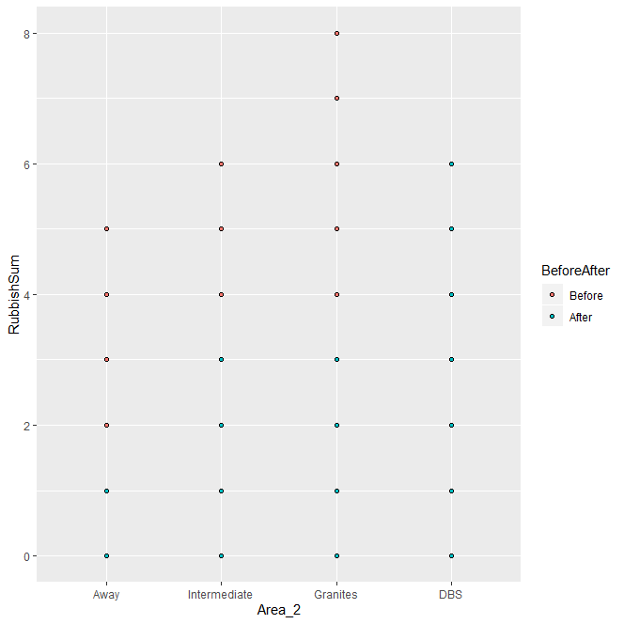
Step 1) Pick a suitable model to fit to the data via Exploratory Data Analysis (EDA).
So here is a plot for each of the 4 sites. But it’s not very good since all the scats are overlayed on each other.
EG: all the Away Scats that had 1 piece of rubbish in them are being plotted at the same point.
> windows()
> ggplot(data = data, aes(x=Area_2, y=RubbishSum, fill=BeforeAfter)) + geom_point(pch=21)

Slide 101
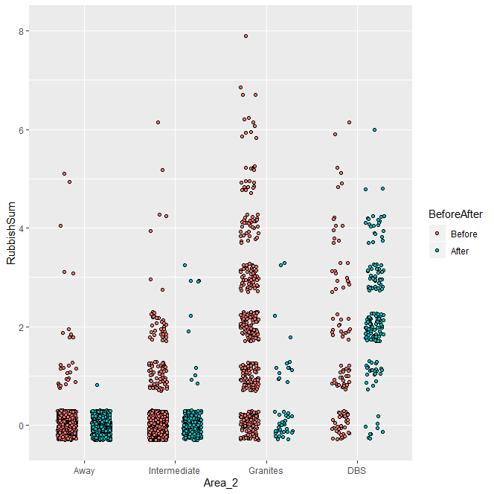
Step 1) Pick a suitable model to fit to the data via Exploratory Data Analysis (EDA).
To fix this I add a jitter - to the plot only, not the data we model.
Now I can see that the number of scats with rubbish in them has dropped after the fences were installed. Except at DBS for some reason?
The reason was that they broke through the fence wasn’t, so they all went over there!!
> windows()
> ggplot(data = data, aes(x=Area_2, y=RubbishSum, fill=BeforeAfter)) + geom_point(pch=21, position=position_jitterdodge(jitter.width=0.4, jitter.height=0.3))

Slide 102
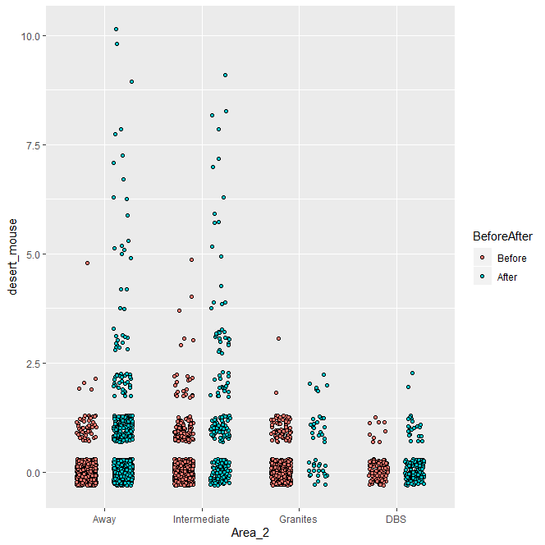
Step 1) Pick a suitable model to fit to the data via Exploratory Data Analysis (EDA).
The model I will show you is for the Desert mouse
> windows()
> ggplot(data = data, aes(x=Area_2, y=desert_mouse, fill=BeforeAfter)) + geom_point(pch=21, position=position_jitterdodge(jitter.width=0.4, jitter.height=0.3))

Slide 103
Step 1) Pick a suitable model to fit to the data via Exploratory Data Analysis (EDA).
Poisson GLM might be a good fit, so let’s try that meaning:
Y_{i} ~ Poisson(λ)
~ mean=variance= λ
We link the linear predictor (Xβ) to λ using the log link i.e. log(λ)=Xβ since that is the conventional model. (NB: this makes a multiplicative model when we back transform to rates).

Slide 104
Step 2) Fit the Model
desert_mouse.p1 <- glm(desert_mouse~Area_2*BeforeAfter, data=data, family="poisson")

Slide 105
Step 3) Check Model Assumptions via Diagnostics: Zero Inflation
Sometimes we get count data with far too many zeros for the Poisson distribution to handle. This is called Zero Inflation.
It often happens if there are effectively 2 processes occurring:
Whether the event occurs
If it does occur, how often it does
Simplistically fitting 2 models is an older way around this (called 2 step/stage or hurdle models). These fit a binomial (logistic) model to whether the event occurs, and then a Poisson if it does. The modern approach is to use Zero Inflated Poisson (ZIP) and Zero Inflated Negative Binomial (ZINB) models that effectively combine these 2 models into a single model fit.

Slide 106

Step 3) Check Model Assumptions via Diagnostics: Zero Inflation
A rough test for this is to simulate the number of zeros we expect based on the overall average and then compare it to what we have. If it is very different we may need some type of ZIP model.
Below shows we may have more zero’s than the theoretical distribution. But I have seen much worse and this is only rough since it’s actually the conditional theoretical distribution we should be comparing to. So it isn’t bad enough to be overly worried about.
Theoretical Distribution
Actual Distribution
> mean(data$desert_mouse)
> test.0i.theory <- rpois(mean(data$desert_mouse), n=10000)
# better to use proportion with large N since it will be stable. count of 0's at low n will not be.
> prop.table(table(test.0i.theory))*100
> round(prop.table(table(data$desert_mouse))*100,2)

Slide 107

Step 3) Check Model Assumptions via Diagnostics: Overdispersion
For the same reasons explained in logistic regression Poisson distributions can be over dispersed i.e. there is too much variance for the single parameter in the Poisson distribution to handle.
We test this using a function from http://bbolker.github.io/mixedmodels-misc/glmmFAQ.html#overdispersion. There is ongoing research on this topic so more recent information and solutions may be available here.
This function tests whether the dispersion parameter is different to 1, which is what a Poisson distribution assumes. It tells us that although there is statistically significant overdispersion it is not very large at only 1.6, so not worth worrying about. What is considered too large is domain specific and subject to ongoing research, I have seen cutoffs from 1.10 – 5 used.
Common ways to deal with this are:
Distributional Regression. 2 distributions are commonly used:
  Negative Binomial distribution - fits a more suitable distribution with an extra dispersion parameter, there are a variety of R packages (including gamlss.dist) that fit this model and is usually available in other software such as SPSS. Very commonly used.
  Generalised Poisson distribution - fit in R using the gamlss.dist package and the GPO distribution, harder to fit in other software.
Fit an individual level random effect using a GLMM (this tricks the model into adding an extra variance parameter).
Quasi-Poisson can also be used. Given the above alternatives there is some debate on how useful it is due to the difficultly in applying inferential methods such as likelihood ratio test, AIC, etc. http://bbolker.github.io/mixedmodels-misc/glmmFAQ.html

Slide 108
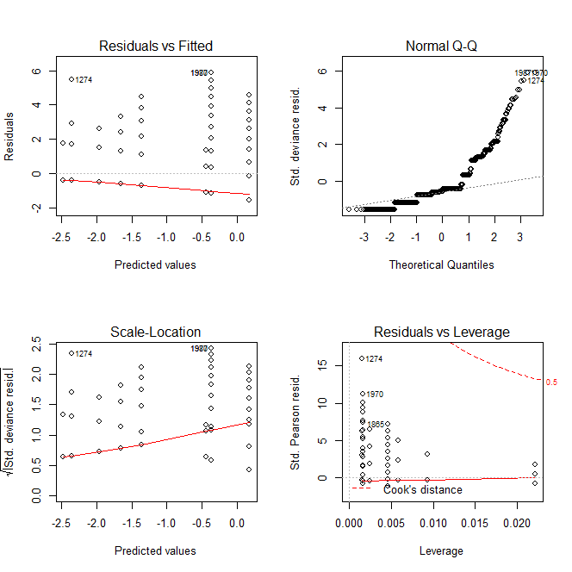
Step 3) Check Model Assumptions via Diagnostics: Residuals
No obvious influential outliers
No systematic patterns we need to account for
  The discrete lines are caused by the 8 combinations of treatments i.e. 4 sites before and after = 8
Residuals aren’t normal, but nor
do we expect them to be. They’re
Poisson!
Dharma residuals are more useful
and are in the R workflow which can
be downloaded from our online
library.
# Standard plots
> windows()
> par(mfrow=c(2,2))
> plot(rubbish.p1)

Slide 109
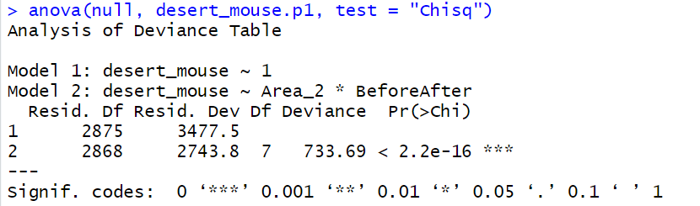
Step 4) Goodness of Fit: Compare to NULL model
It’s a much better fit than the NULL model.

Slide 110
Step 4) Goodness of Fit: What is it’s Pseudo R-Squared?
Technically there is no Pseudo R-Squared for a GLM, however there is an equivalent based on the % Deviance explained.
Which in this case is acceptable, at 57%

Slide 111
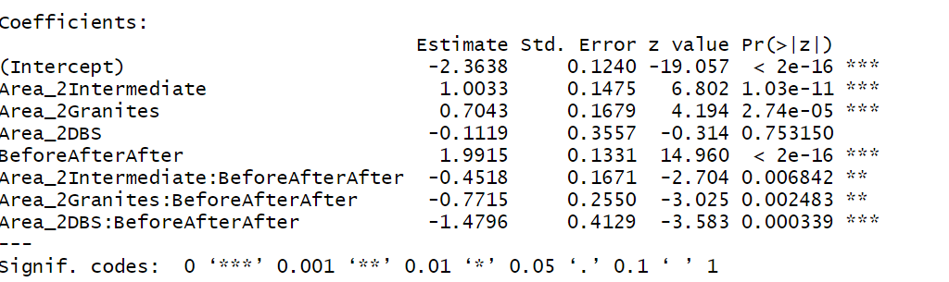
Step 5) Interpret Model Parameters and reach a conclusion
For Simple Linear models we can simply look at the parameter estimate summary and CI’s. BUT in Poisson regression these are hard to interpret as they are still on the log scale (which was our link function).
The only really useful part of this ‘raw’ output is the p-value associated with the parameters. Which in this case shows strong evidence of Intermediate and Granites being different from Away (Intercept), Before/After and the interactions (which means the Before/After effect differs between sites) – since p values are so small.

Slide 112

“Graphs allow us to view complex mathematical models fitted to data, and they allow us to assess the validity of such (statistical) models” (Cleveland 1994, author of “The elements of graphing data” and “Visualising data”).

Slide 113
Step 6) Reporting: Overall Conclusion suitable for publication
“The model is a good fit to the data with a pseudo R²=57%. There were no outliers or unexplained structure.
The model fit was a GLM with Poisson distribution and log link function. There was no evidence of over dispersion or zero inflation.”
But as it’s a complex design with a lot going on we will use a plot to report the patterns and effects.
Notes:
Here’s an example of when R² is too high, and one might think the model has been overfit.

Slide 114
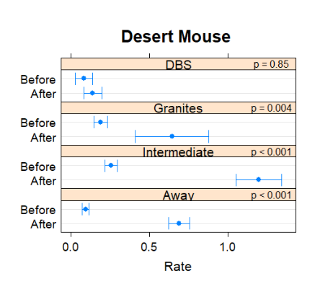

Step 6) Reporting: Overall Conclusion suitable for publication
So far our examples have had few predictors and easy interpretation, so the words I’ve been giving you have been sufficient.
More complex designs with more
predictors often require novel
reporting methods. And charts are
a great way to do that.

Slide 115
Step 6) Reporting: Overall Conclusion suitable for publication
We actually used this chart. Where the p-value at the top right is the specific t-test comparing Before vs After for each site, adjusted for multiple comparisons using Tukeys. The response has been adjusted to the response scale. The interpretation is:
DBS, where dingos could still access garbage, is the only site where there is no evidence of dingos eating more Desert Mouse after the tips were fenced. This provides strong evidence that anthropocentric food availability can effect dingos diet and the wider Tanami Ecology.
Interestingly, even at the sites far Away there is very strong evidence of a difference after the tips were fenced with scats having Desert Mouse in them increasing to a rate of [95%CI: 0.6-0.8] from [95% CI: 0.07-0.12] before the tip was fenced. There is strong evidence these rates have changed (p<0.001).

Slide 116
Step 6) Reporting: Overall Conclusion suitable for publication
This type of chart can be used for any GLM.
Not just Poisson.
This is the power of GLM’s, similar
charts work for all of them. So what
you learn for one type of data you
can easily apply to other types.

Slide 117
Step 6) Reporting R code
?pmmeans
(desert_mouse.p1.mm1 <- pmmeans(desert_mouse.p1, ~BeforeAfter|Area_2, transform="response"))
# Chart
windows()
plot(desert_mouse.p1.mm1, main="desert_mouse")
# P-values
(desert_mouse.p1.mm2 <- pmmeans(desert_mouse.p1, specs=c( "BeforeAfter", "Area_2"), transform="response"))
(desert_mouse.pw <- summary(pairs(desert_mouse.p1.mm2)))

Slide 118

1:25

Slide 119
Other Resources

Slide 120

Further Assistance: Sydney University
SIH
1on1 Consults can be requested on our website:
www.sydney.edu.au/research/facilities/sydney-informatics-hub.html OR Google “Sydney Informatics Hub” with the “I’m feeling lucky” button
Training Sign up to our mailing list to be notified of upcoming training: https://signup.e2ma.net/signup/1945889/1928048/
  Research Essentials
  Experimental Design
  Power Analysis
Online library. Useful links and the most recent version of all our workshops.
  https://sydney-informatics-hub.github.io/stats-resources/
Hacky Hour
www.sydney.edu.au/research/facilities/sydney-informatics-hub/workshops-and-training/hacky-hour.html OR Google “Sydney Hacky Hour”
OTHER
Open Learning Environment (OLE) courses
  Science: OLET5608 Linear Modelling: Exploratory data analysis, sampling, simple linear regression, t-tests and confidence intervals. Ability to perform data analytics with coding, basic linear algebra.
  Business: BSTA5007 Linear Models
  Many others, and constantly changing, so have a look at what is available by getting the list and searching for key words such as linear, regression, GLM, ANOVA, etc.
Linkedin Learning: https://linkedin.com/learning/
  SPSS https://www.linkedin.com/learning/machine-learning-ai-foundations-linear-regression/welcome?u=2196204

Slide 121
Other SIH workshops
Linear Models 1: Basic intro to Linear models with a normal (gaussian) error. Example workflows for Simple Linear Regression, ANOVA, ANCOVA, mixed models.
Linear Models 2: Extends the Linear Model framework introduced in LM1 to Generalised Linear Models which allow non normal errors and responses. Example workflows for Poisson (Count) and Logistic (Binary) regression.
Linear Models 3: Tricks of the Trade including model interpretation and reporting tricks for finding patterns that capture attention, different ways to code categorical data (parametrising the data).
Model Building: LM workshops use simple 1 or 2 predictor examples. More than this requires additional Workflow steps and possibly different Methods to account for things like Multi-Collinearity. These additional topics are covered in this workshop.

Slide 122
Further Assistance
  VIDEOS
  StatsQuest with Josh Starmer
    Linear Models: https://www.youtube.com/playlist?list=PLblh5JKOoLUIzaEkCLIUxQFjPIlapw8nU
    What is a Statistical Model https://www.youtube.com/watch?v=yQhTtdq_y9M
    Logistic Regression: https://www.youtube.com/watch?v=yIYKR4sgzI8
  Zedstatistics, longer videos than StatsQuest. https://www.youtube.com/c/zedstatistics
  WEBSITES
  R GLMM FAQ https://bbolker.github.io/mixedmodels-misc/glmmFAQ.html
  BOOKS AND PAPERS
  Julian J Faraway (2006) Extending the Linear Model with R. Chapman & Hall.
  John Fox (2008) Applied Regression Analysis and Generalized Linear Models. Sage.

Slide 123
Tricks to learning – R, linear models, SPSS, etc
The trick is doing a little bit everyday and getting really good at it so by the time you get to actually needing R you are comfortable in it.
When working an actual problem let yourself ‘process’ problems overnight. I’ve lost count of the time times I have battled for hours only to wake up the next day and nail it.
As tempting as it is. Don’t just google stuff, if you get to know your books and references it will give you a broader understanding, which will help you in the long run.
Create an R script with your ‘training code’. So as you read the book jump into R and try stuff out. Get used to creating sample data to test stuff out.
And I’ll leave you with a paraphrased quote from one of the R guru’s Hadley Wickham “Frustration is good, it means you’re at the edges of your understanding and are learning!!”

Slide 124
R: Where to start
BOOKS
Find an intro R book
  Read it a little bit everyday, try and get a routine going such as a little at breakfast, before bed, whatever.
I like this one for a good intro that includes a lot of statistical methods
  R in Action by Robert I Kabacoff
  It also has a great web page resource which is a good first port of call too
    https://www.statmethods.net/
    Buy through Web site for a discount
Only downside is that it doesn’t use Hadley Wickhams packages, so I would also recommend one of his. In particular R for Data Science gives a great intro to data wrangling and visualisation using his packages.
Finally I recommend MASS (Modern Applied Statistics in S) by Veneables and Ripley. The ‘Yellow Bible’. It has at least a little bit on pretty much any statistical method you can think of. I tend to start here to get an intro on what R can do and then research outwards.
ONLINE
Lots of short (and long) YouTube courses
  A series of short videos on Logistic Regression https://www.youtube.com/playlist?list=PLblh5JKOoLUKxzEP5HA2d-Li7IJkHfXSe

Slide 125
Acknowledging SIH
All University of Sydney resources are available to Sydney researchers free of charge. The use of the SIH services including the Artemis HPC and associated support and training warrants acknowledgement in any publications, conference proceedings or posters describing work facilitated by these services.
The continued acknowledgment of the use of SIH facilities ensures the sustainability of our services.
Suggested wording:
General acknowledgement:
"The authors acknowledge the technical assistance provided by the Sydney Informatics Hub, a Core Research Facility of the University of Sydney."
Acknowledging specific staff:
“The authors acknowledge the technical assistance of (name of staff) of the Sydney Informatics Hub, a Core Research Facility of the University of Sydney.”
For further information about acknowledging the Sydney Informatics Hub, please contact us at sih.info@sydney.edu.au.

Slide 126
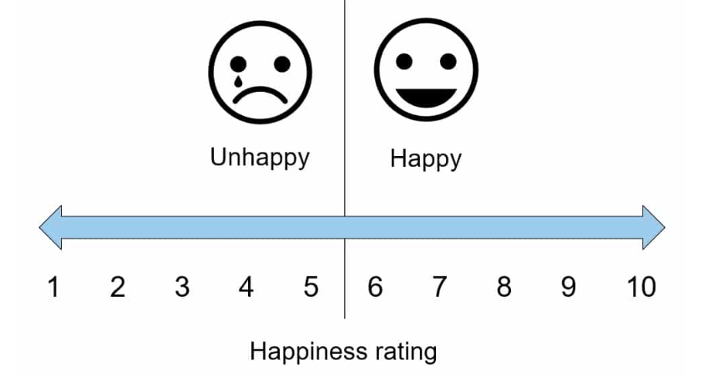
We value your feedback
We will email you a link to the survey shortly
It only takes a few minutes to complete (really!)
Completing this survey is another way to help us keep providing these workshop resources free of charge

